Slide 1
Flexcompute Contribution to the VIIth AIAA Drag Prediction Workshop
Thomas Fitzgibbon, Qiqi Wang and Philippe Spalart
Flexcompute
Presented at the AIAA 2022 Aviation Forum & Exposition

Slide 2
Outline
Flow360 Solver
Grids
Cases
Case 1 – Grid Convergence Study
Case 2 – Alpha Sweep Study
Case 3 – Reynolds Number and Q Effect Study
Conclusions

Slide 3
Flow360 Solver
Hardware/Software co-design with emerging hardware computing
Node-centered
Unstructured solver
2nd order finite volume method
Roe inviscid fluxes
Central difference viscous fluxes
MUSCL Extrapolation
SA, SA-RC, SA-QCR, kw-SST turbulence models (DDES, transition also available)

Slide 4
Grids
JAXA grids were used for Flow360 simulations
Mesh Statistics | Number of Nodes | BL 1st cell size (non. dim by c_ref) | BL growth rate
Tiny | 8,687,830 | 8.455E-07 | 1.323
Coarse | 26,891,512 | 5.638E-07 | 1.205
Medium | 60,184,023 | 4.228E-07 | 1.150
Fine | 111,843,367 | 3.383E-07 | 1.118

Slide 5
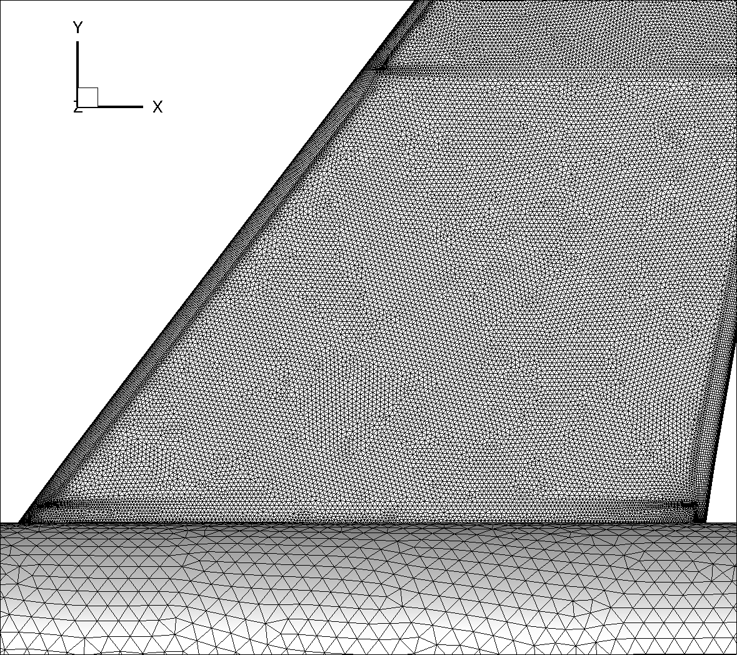
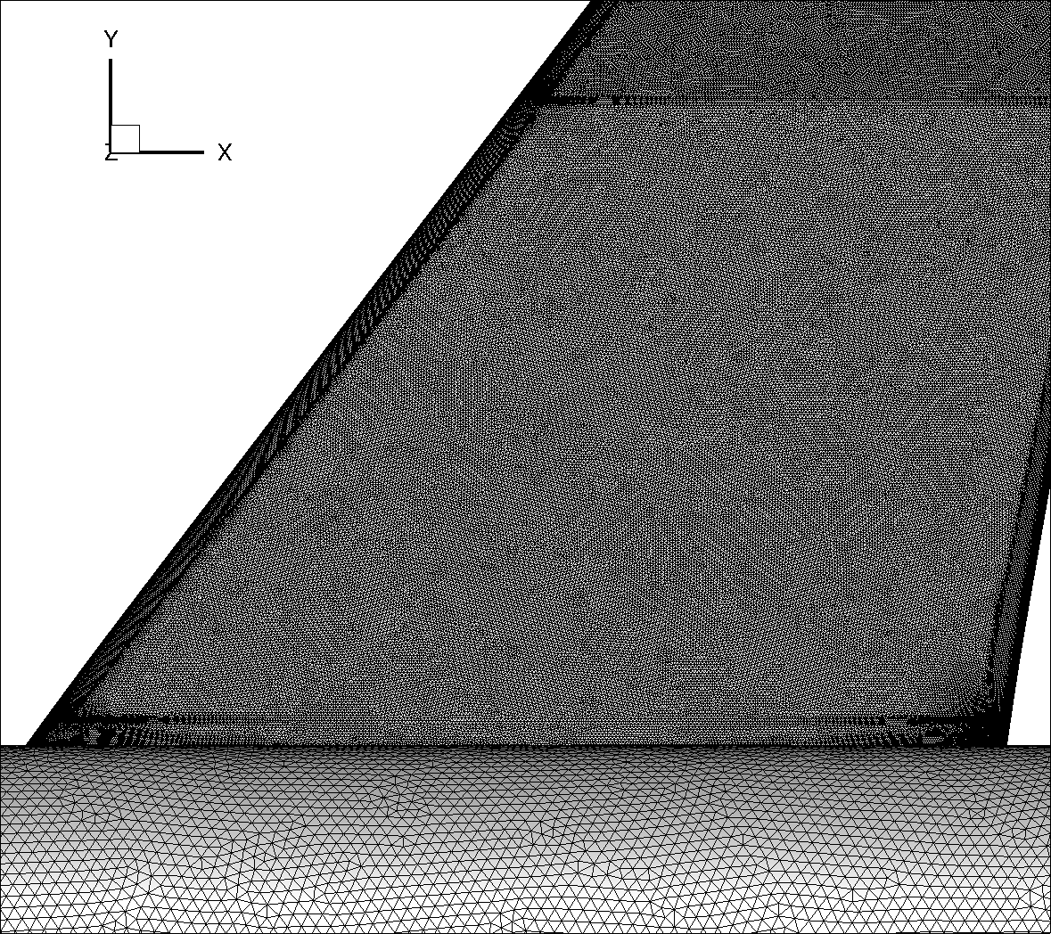
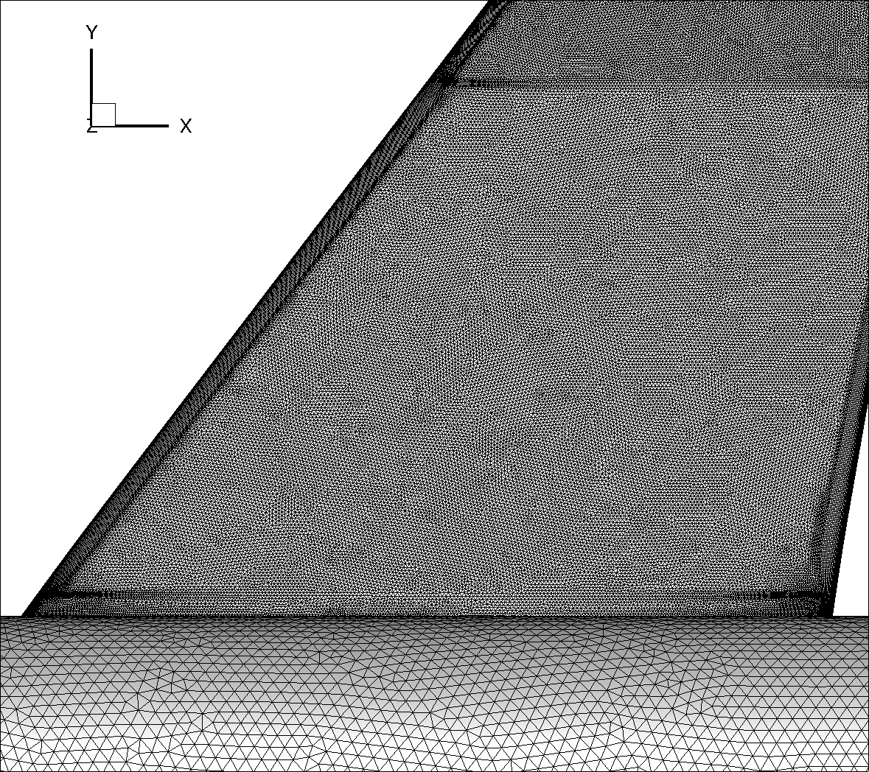
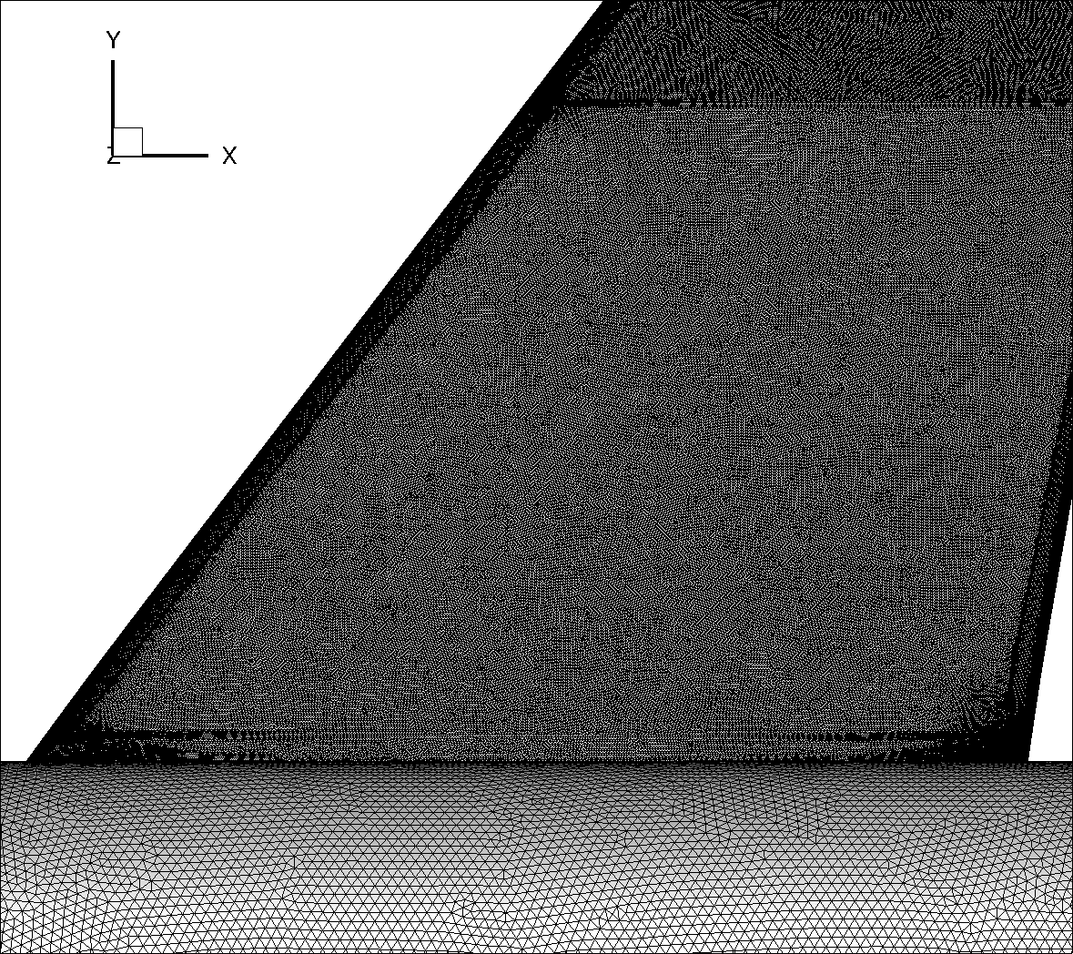
Grids
JAXA grids – Root region
Tiny
Medium
Coarse
Fine

Slide 6
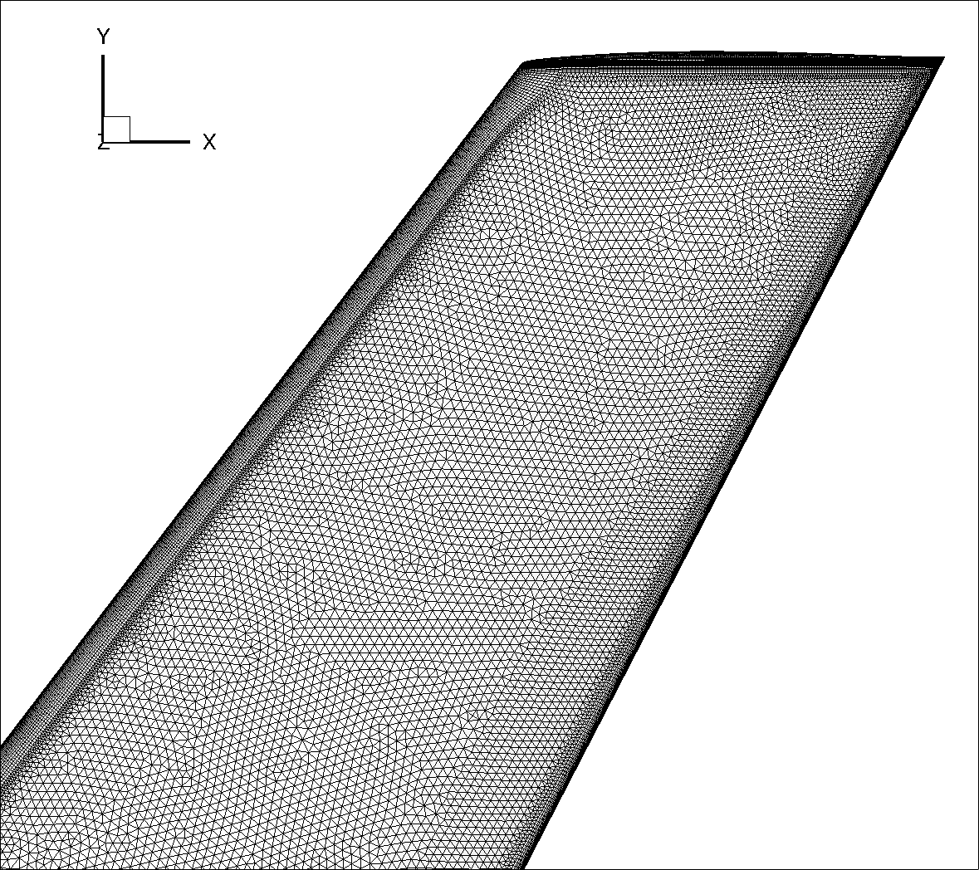
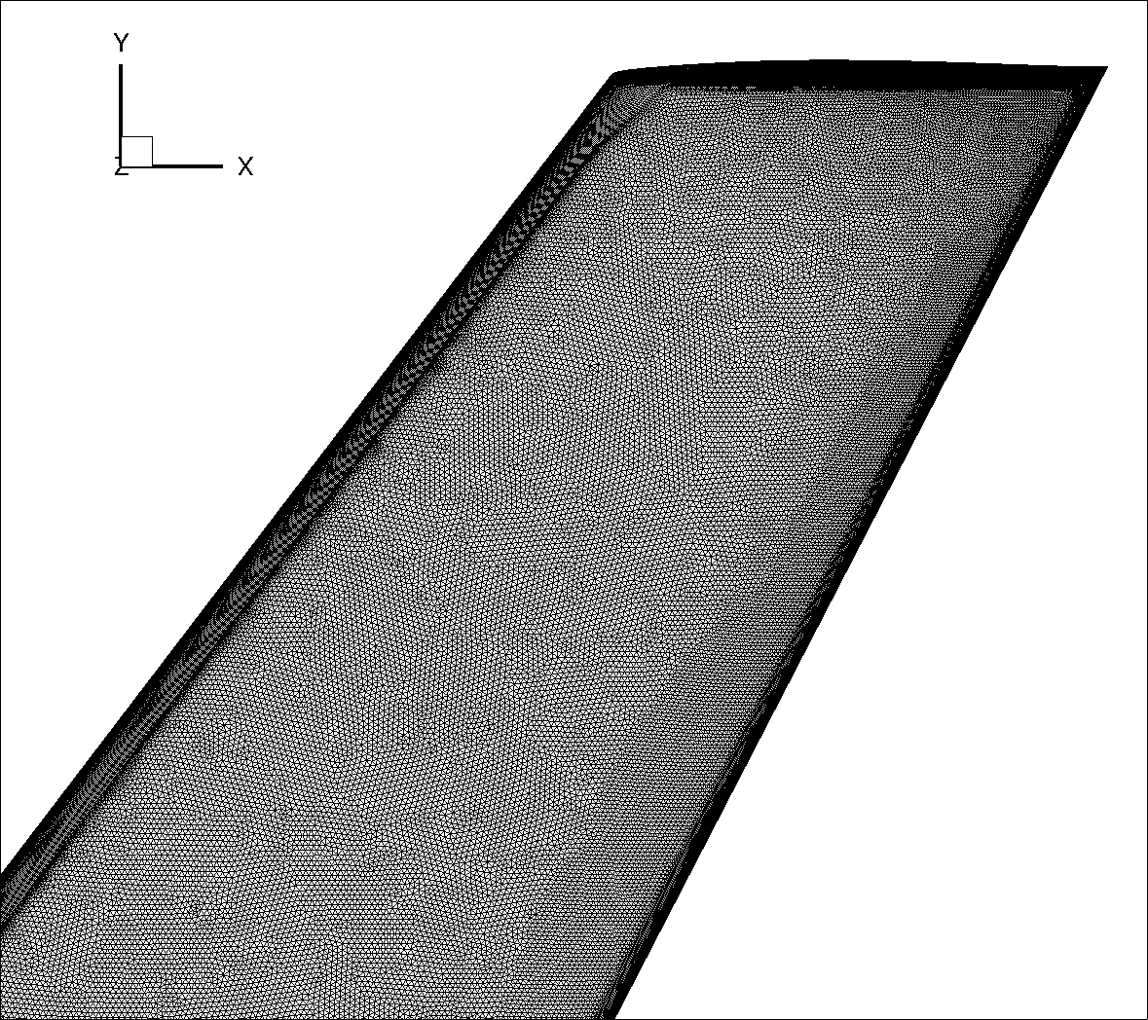
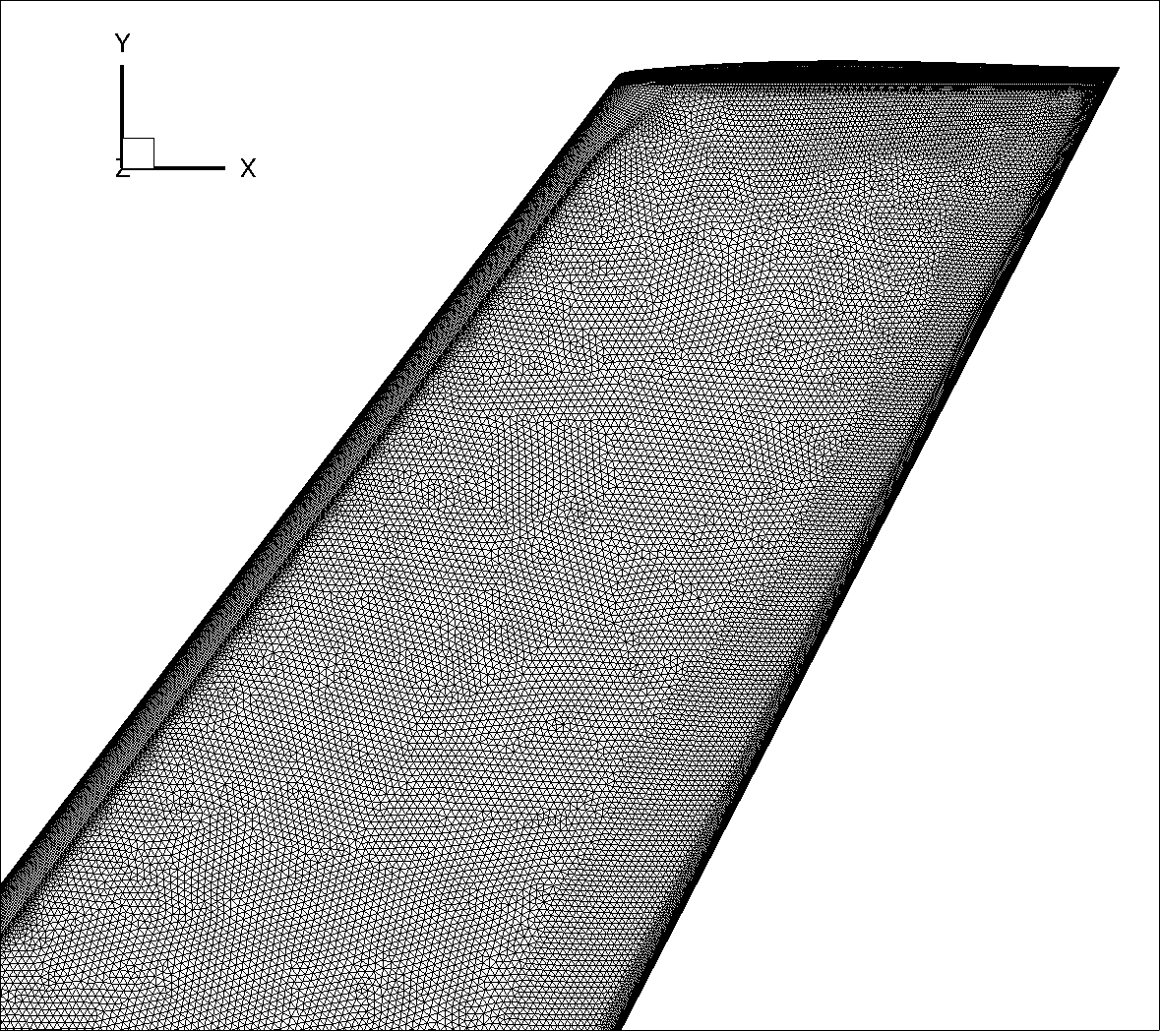
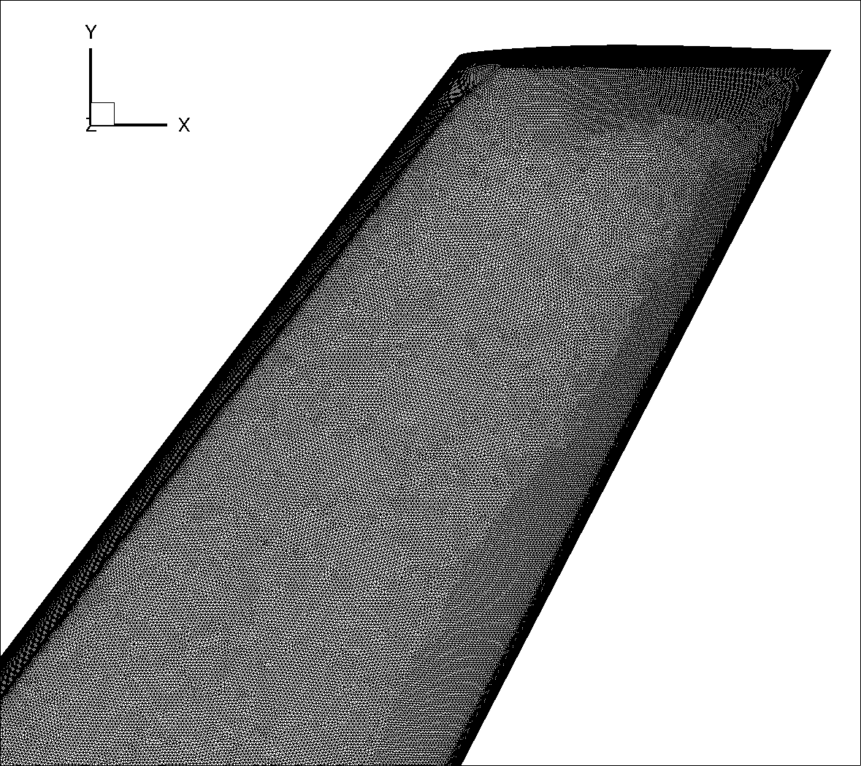
Grids
JAXA grids – Tip region
Tiny
Medium
Coarse
Fine

Slide 7
Test Cases
4 different turbulence models used: SA, SA-QCR, SA-RC-QCR and kω-SST
Case 1 | Case 2 | Case 3
Grids: Tiny – Fine Turbulence models: SA, kω-SST | Grids: Medium Turbulence models: SA, SA-QCR, SA-RC-QCR and kω-SST | Grids: Medium Turbulence models: SA, kω-SST

Slide 8
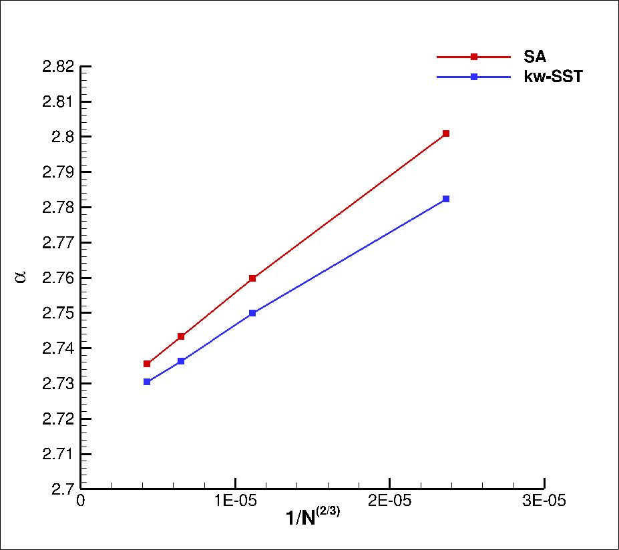
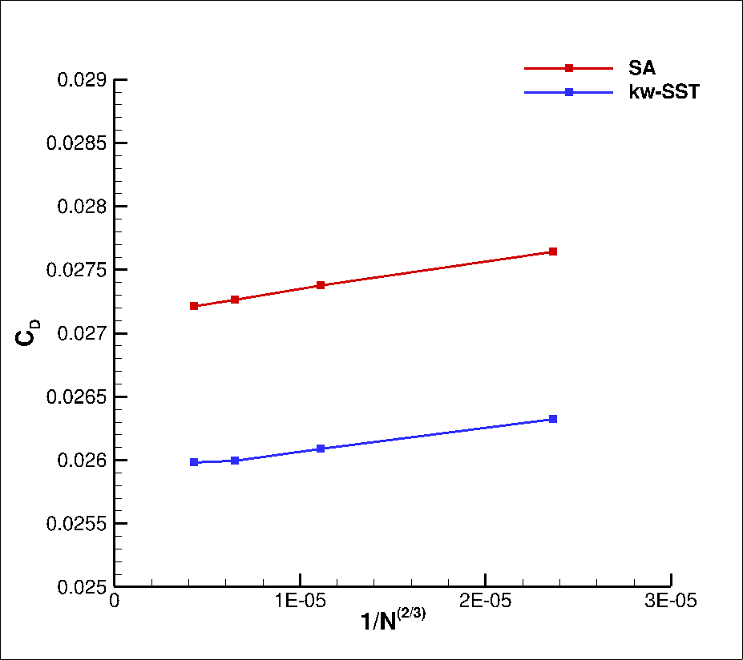
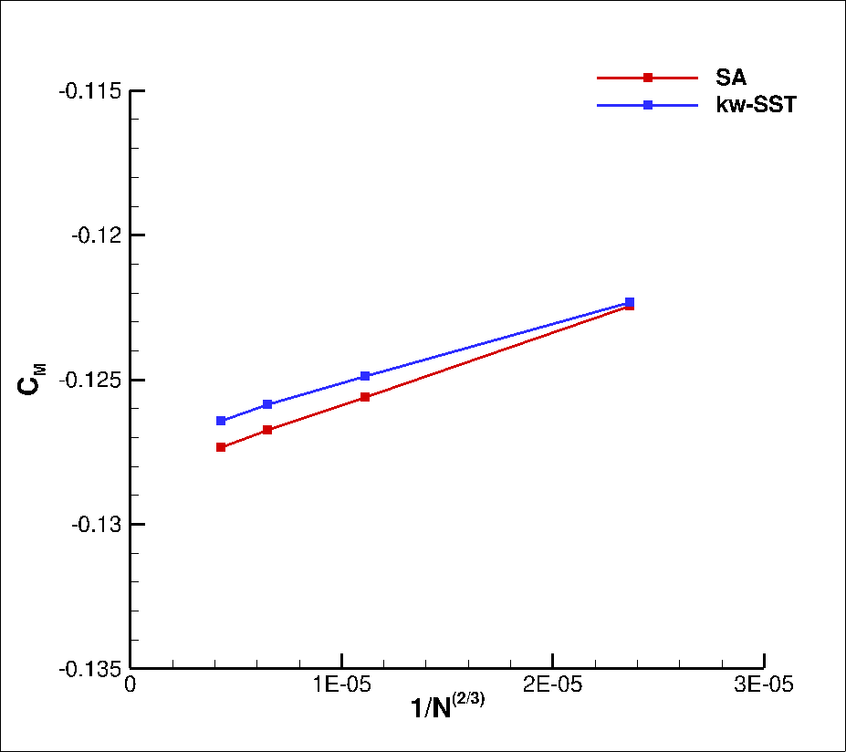
Case 1 - Grid Convergence Study
Alpha
CD
CM

Slide 9
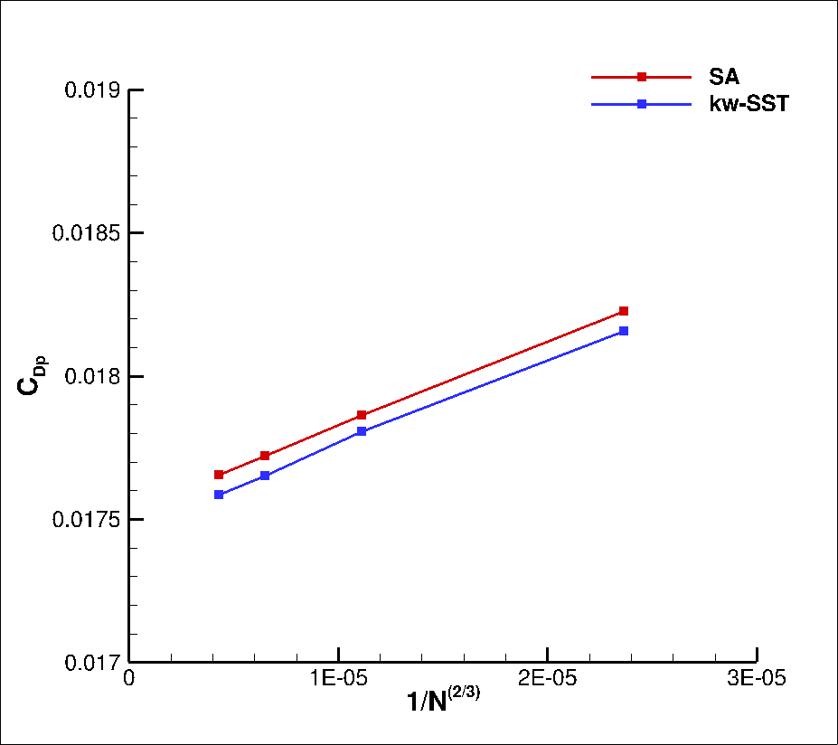
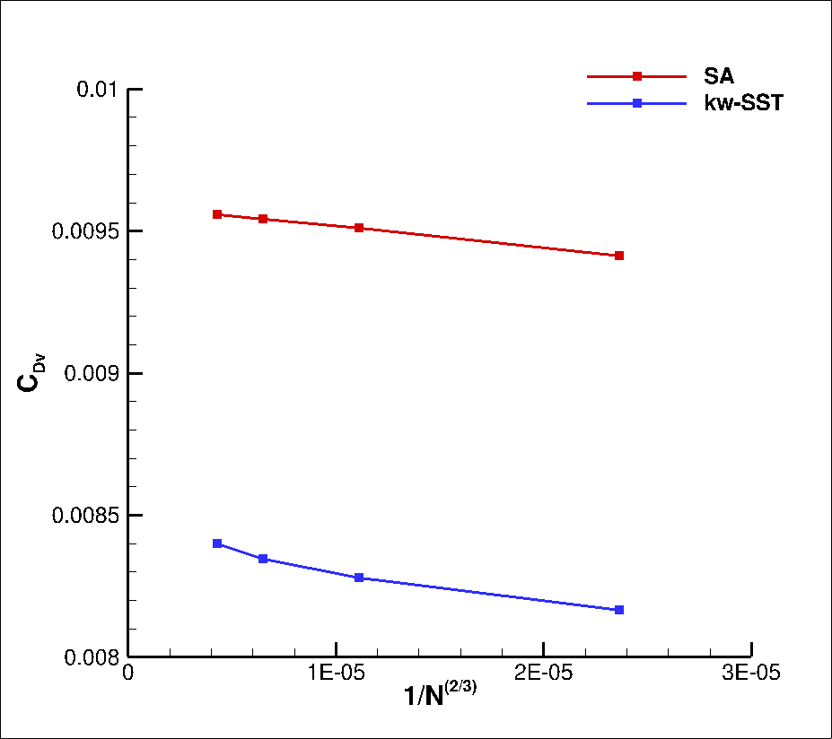
Case 1 - Grid Convergence Study
CDp
CDv

Slide 10
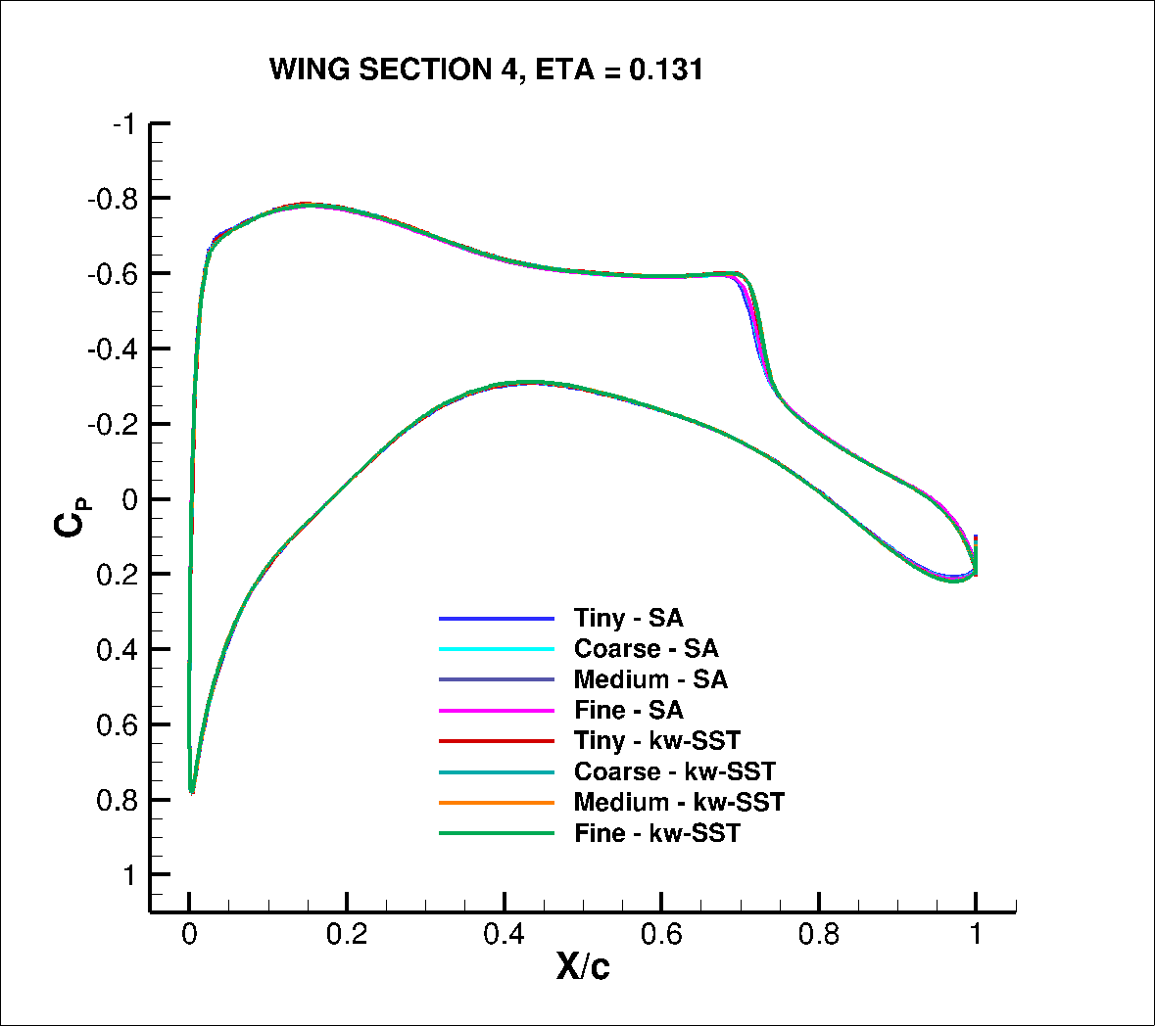
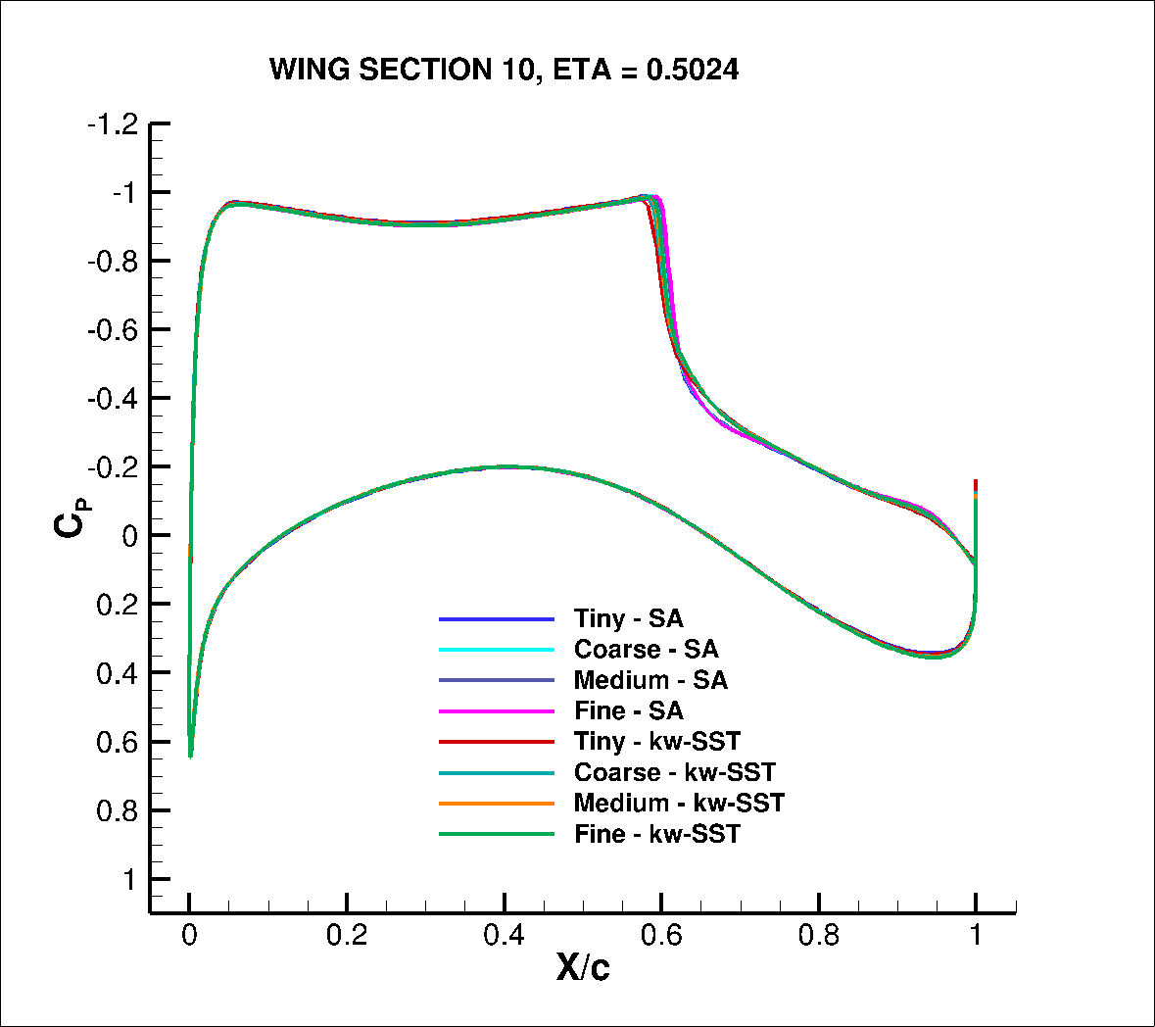
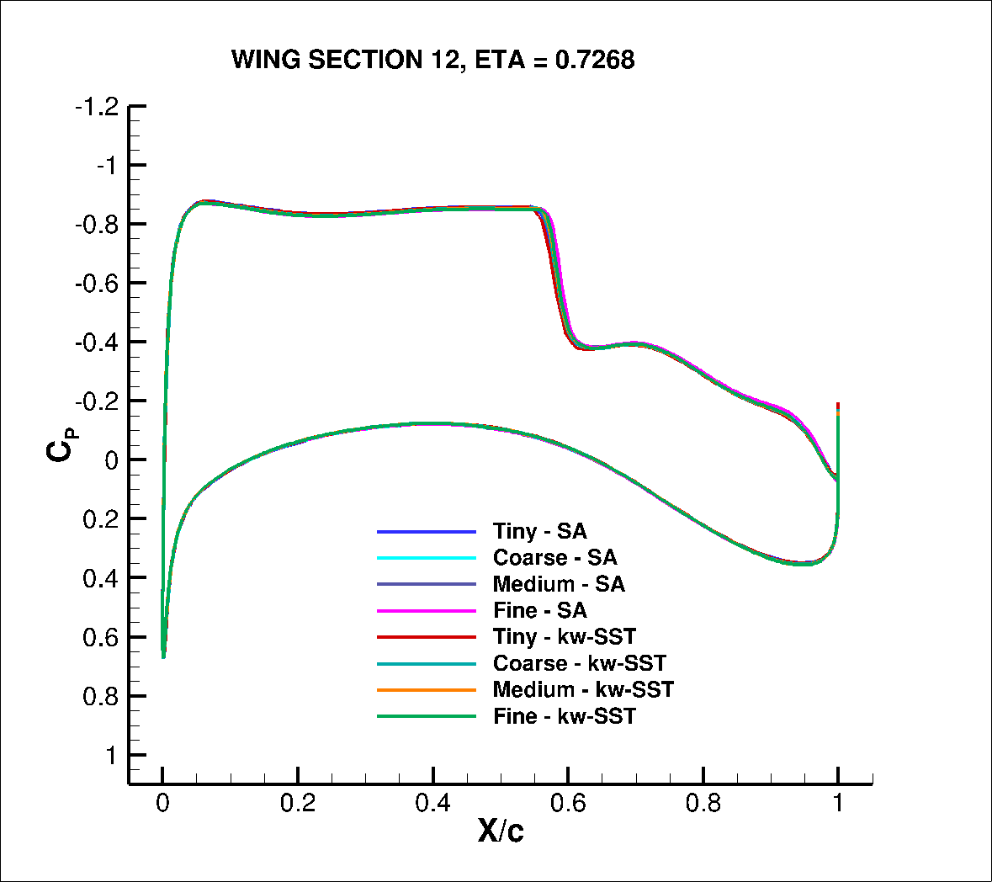
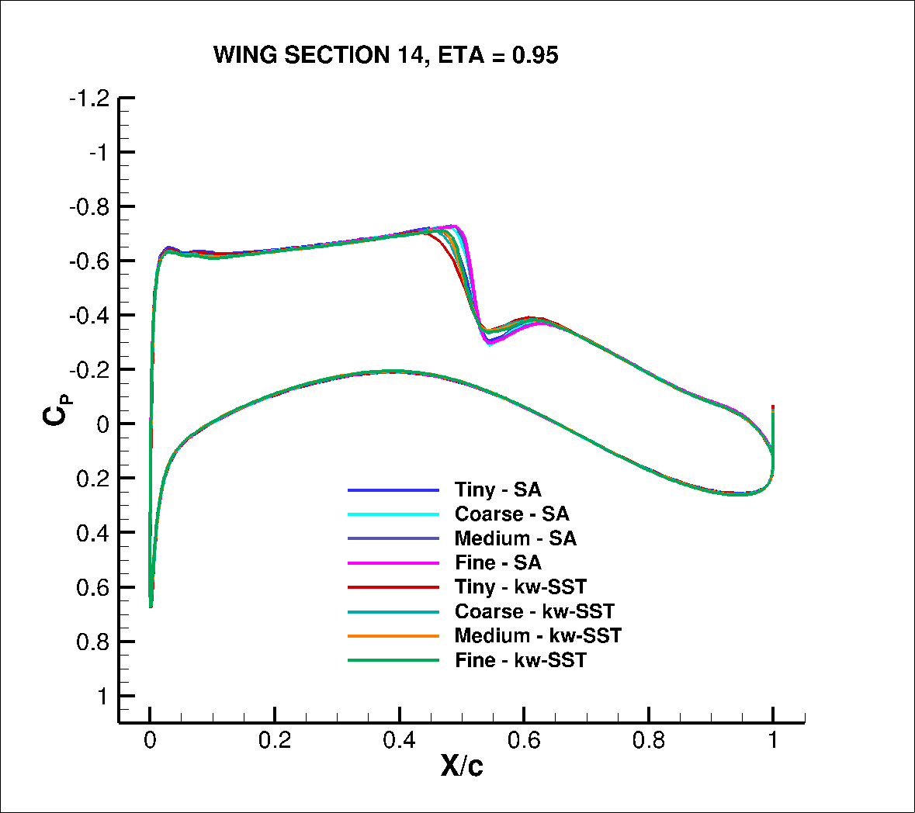
Case 1 - Grid Convergence Study
Surface pressure curves at 4 locations along the wing

Slide 11
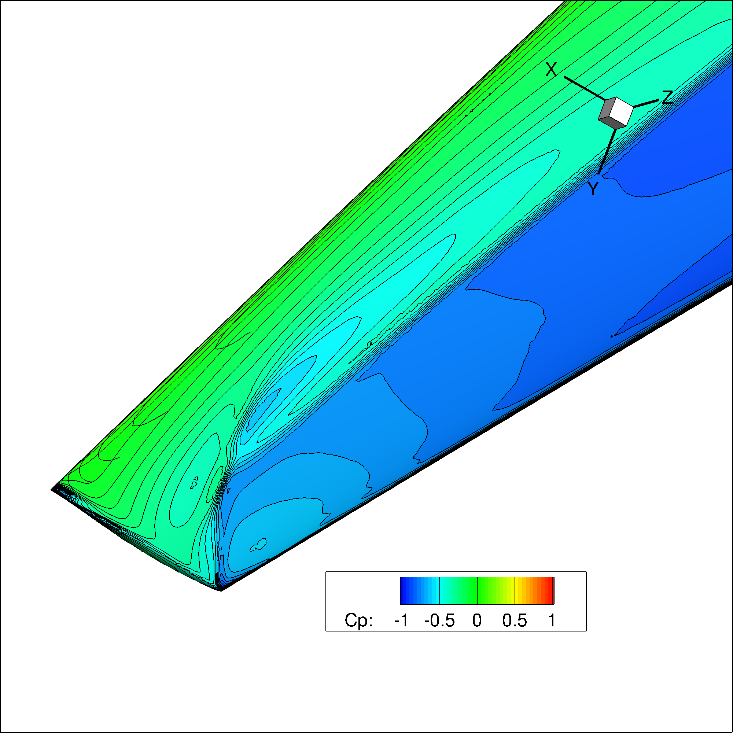


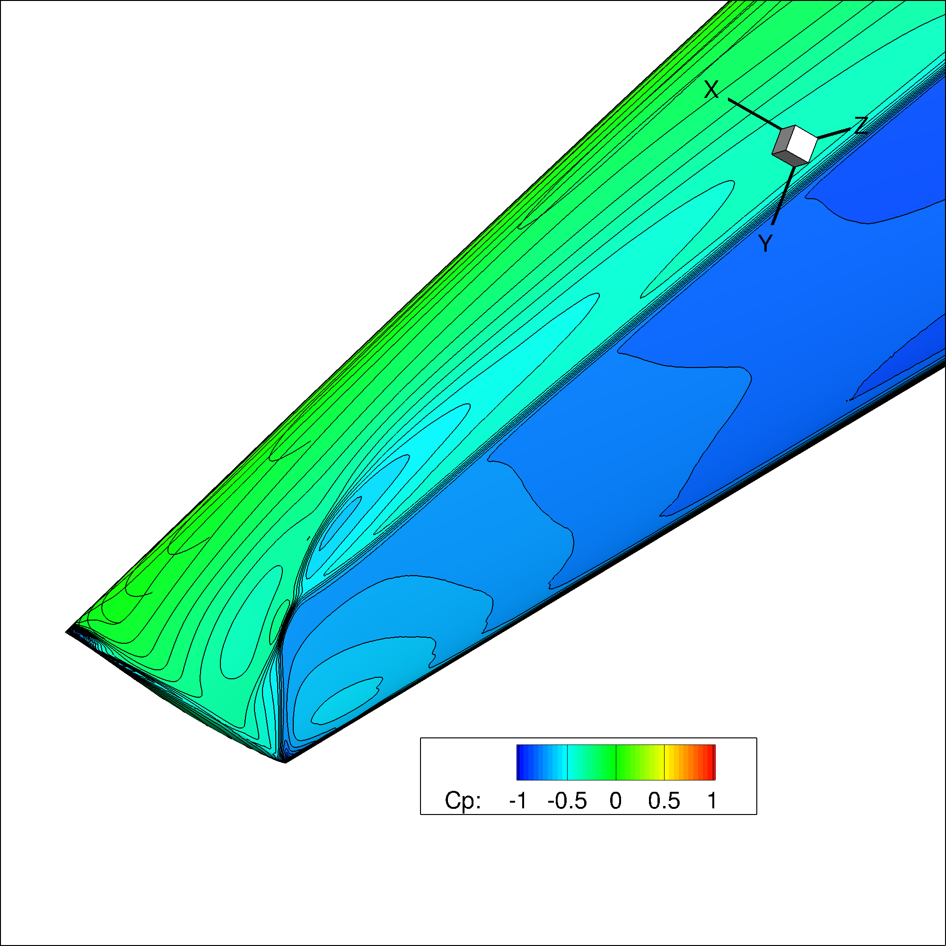




Case 1 - Grid Convergence Study
Tip surface pressure contours
SA
Kw-SST
Tiny
Coarse
Medium
Fine

Slide 12
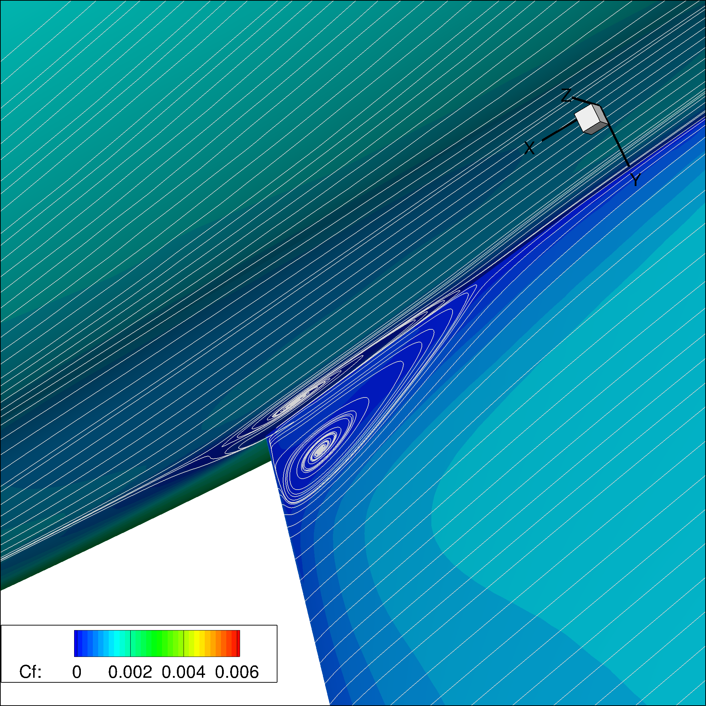



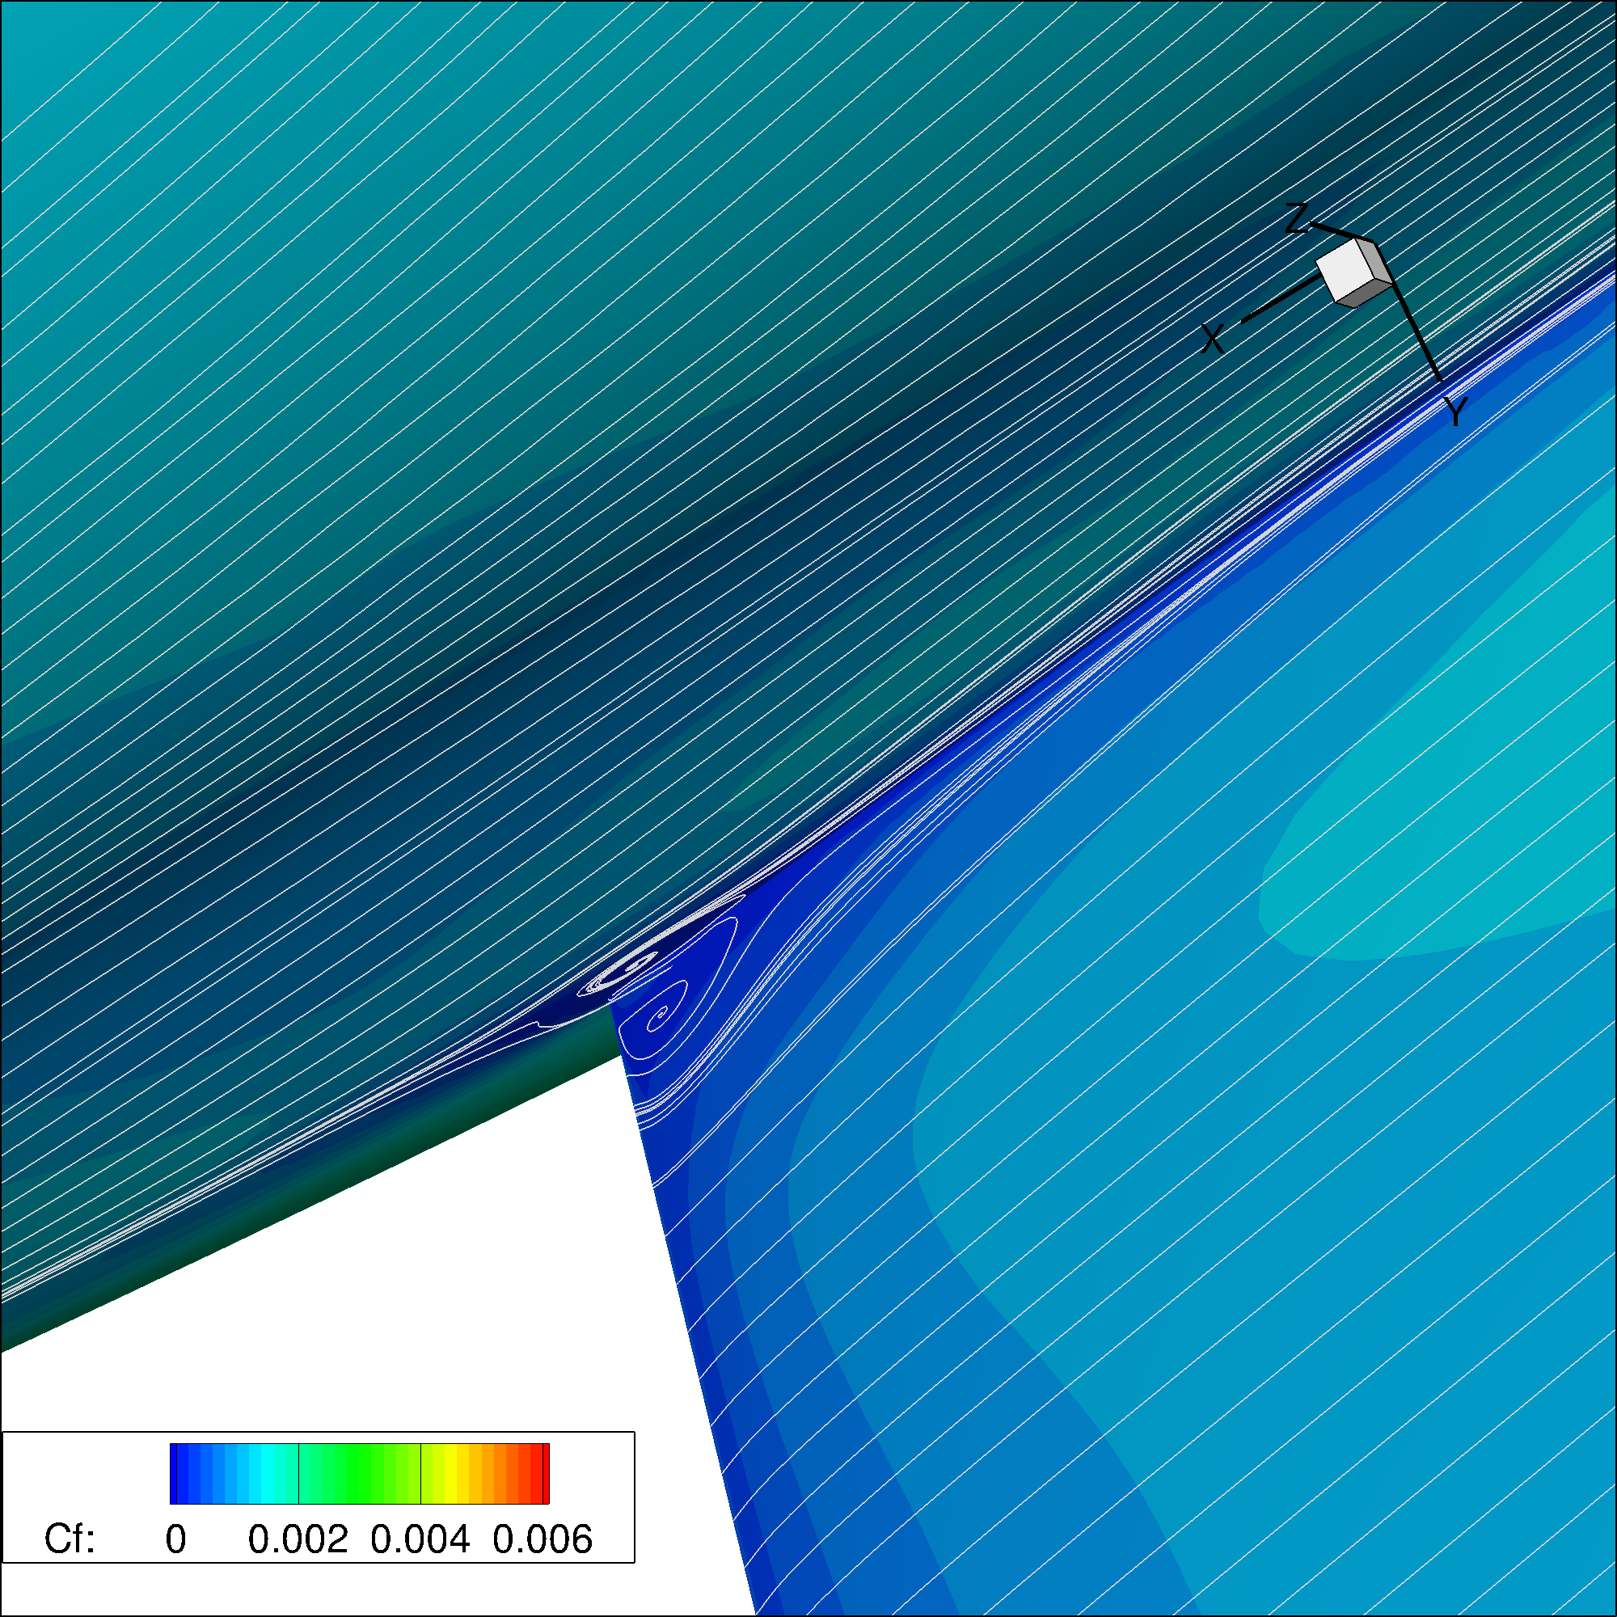
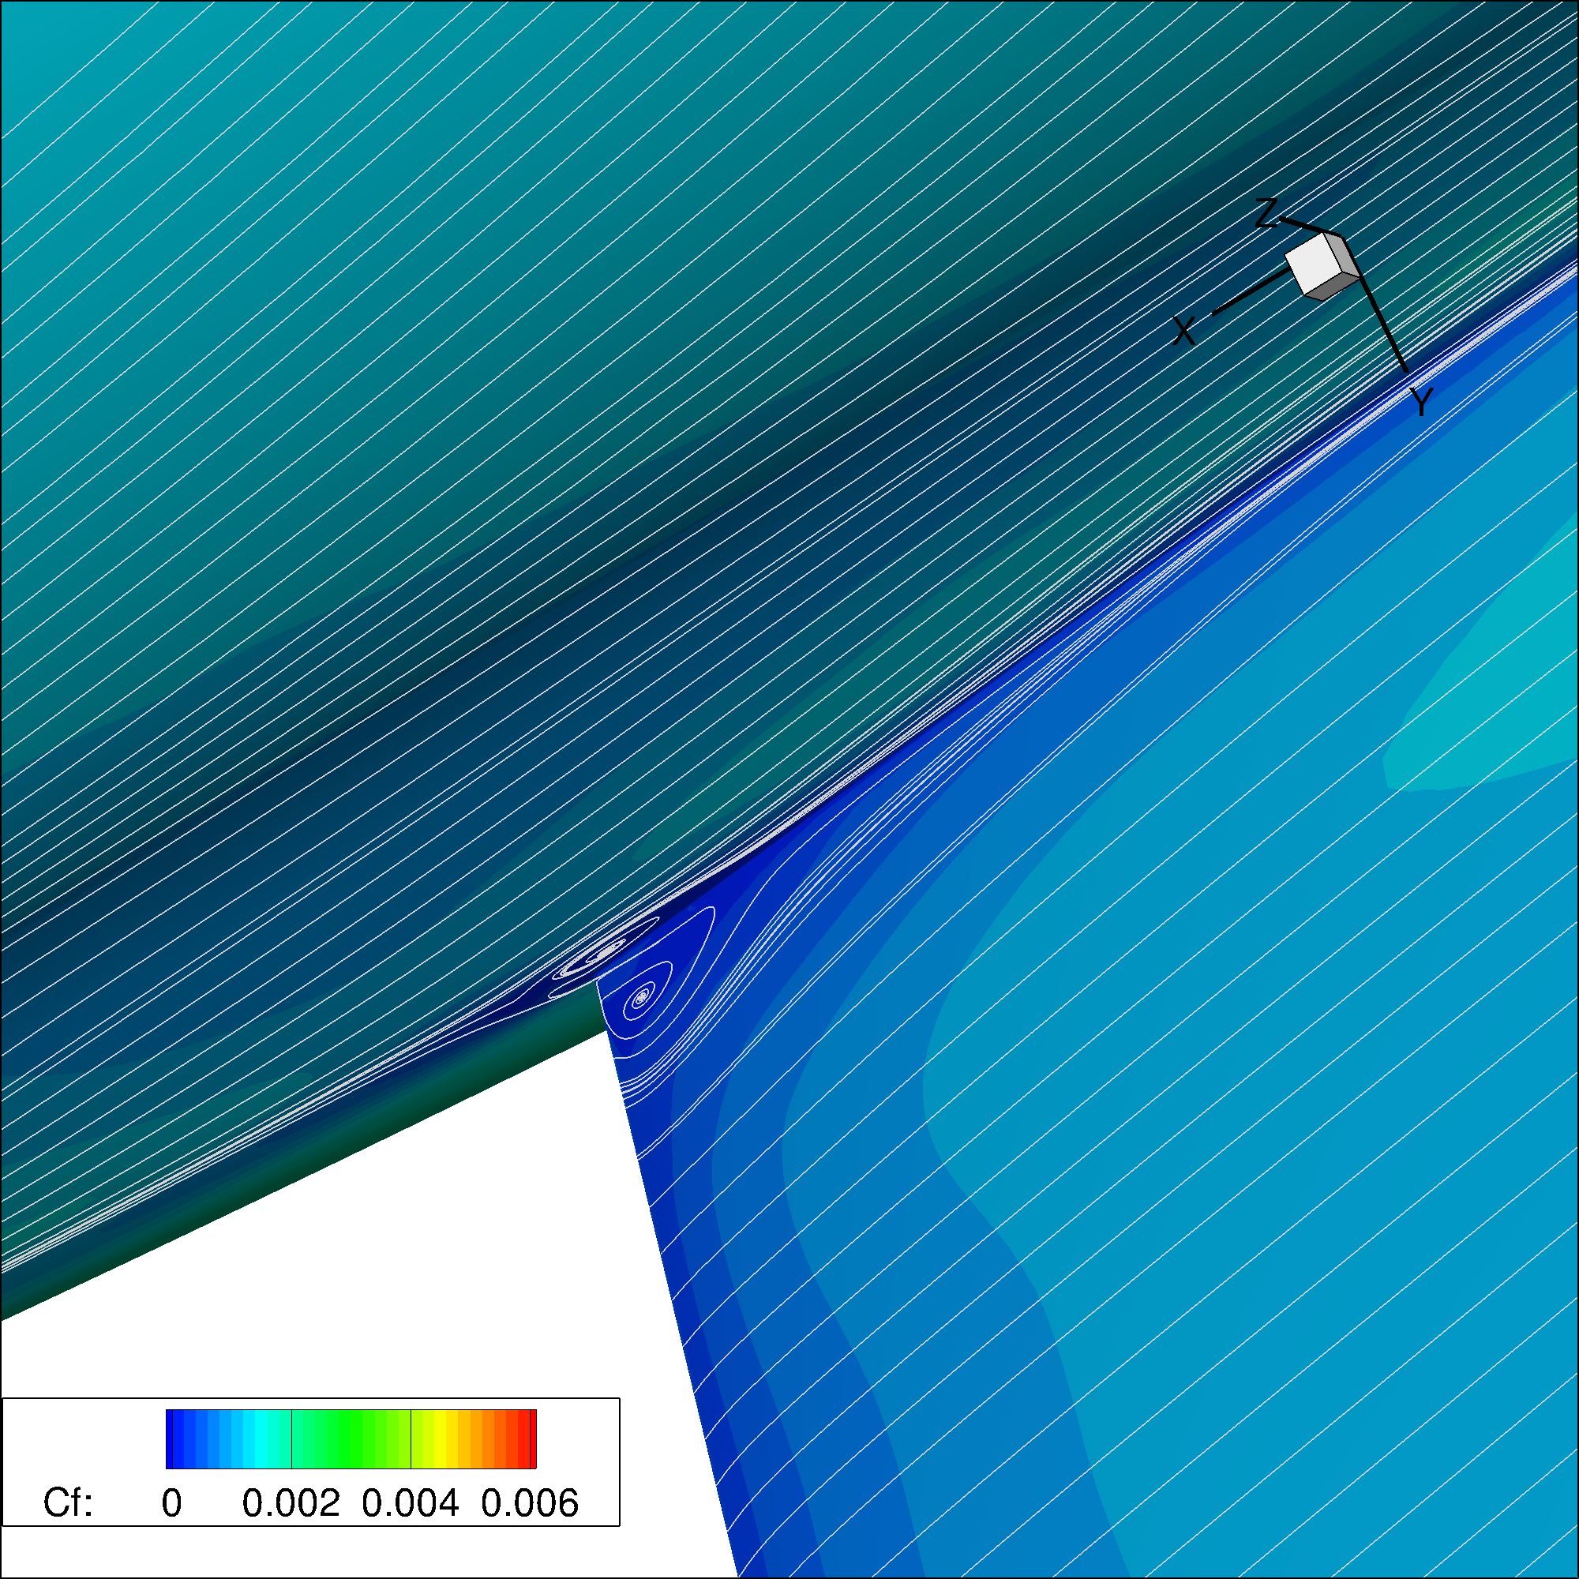


Case 1 - Grid Convergence Study
Corner separation at root
SA
Kw-SST
Tiny
Coarse
Medium
Fine

Slide 13
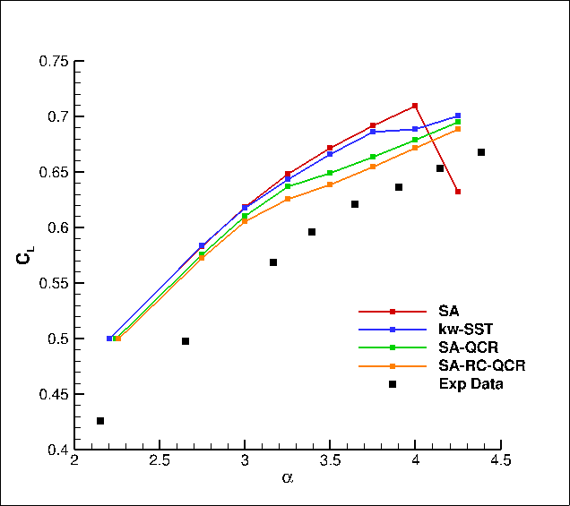
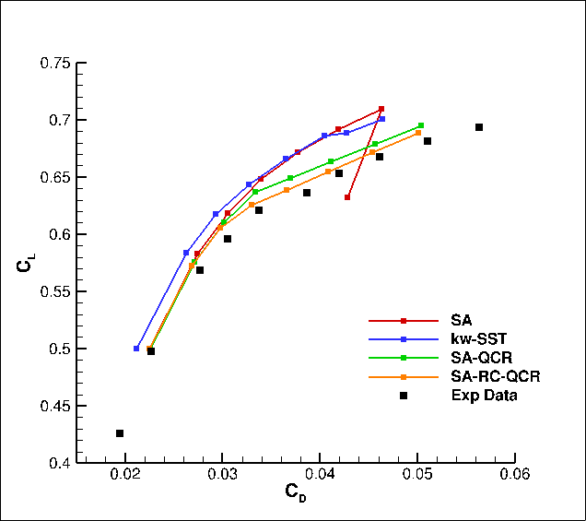
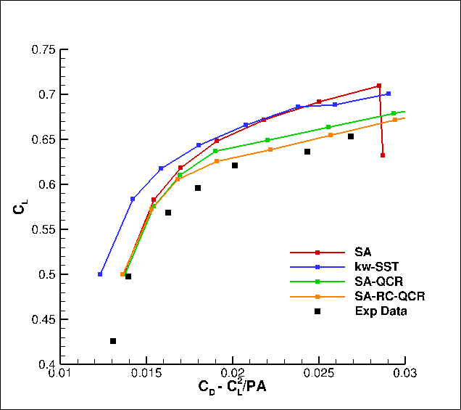
Case 2 – Alpha Sweep Study
CL
CD
CD Trim
t197R165 experimental data

Slide 14
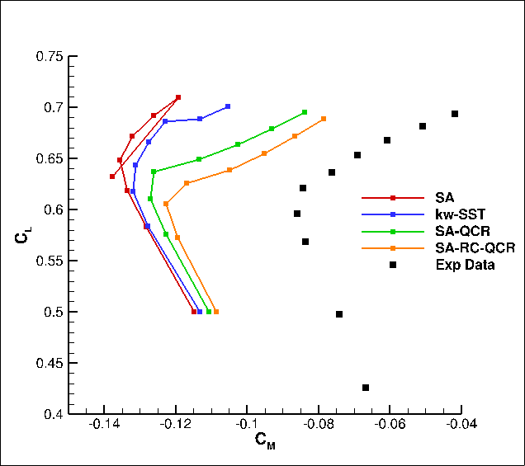
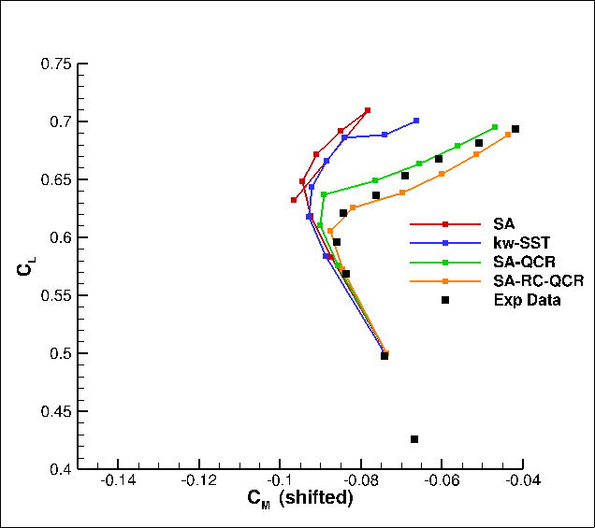
Case 2 – Alpha Sweep Study
CM
CM + shift
t197R165 experimental data

Slide 15
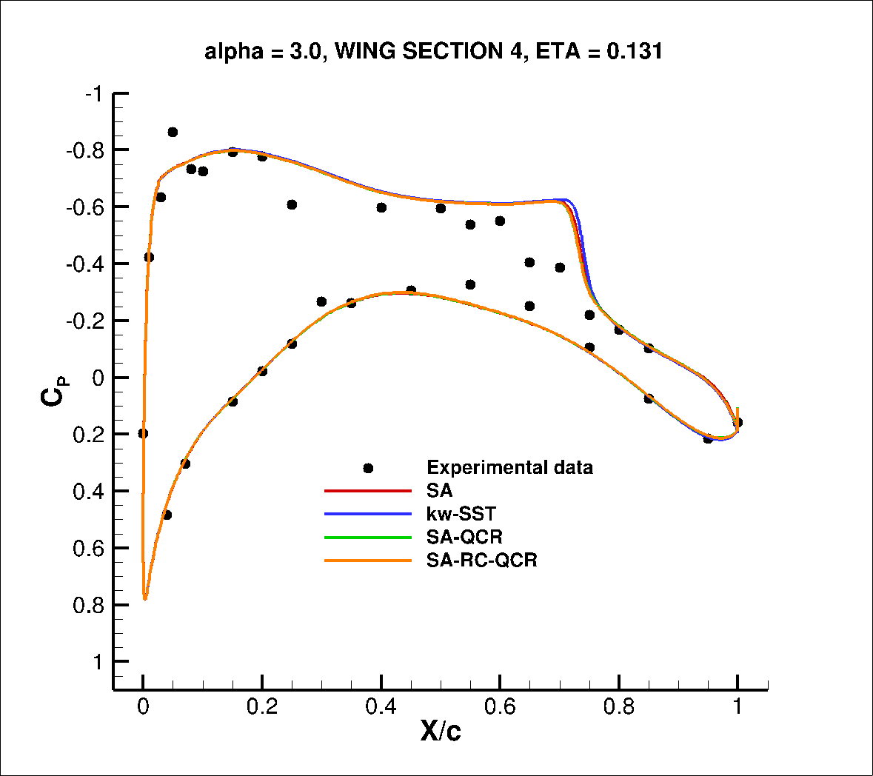
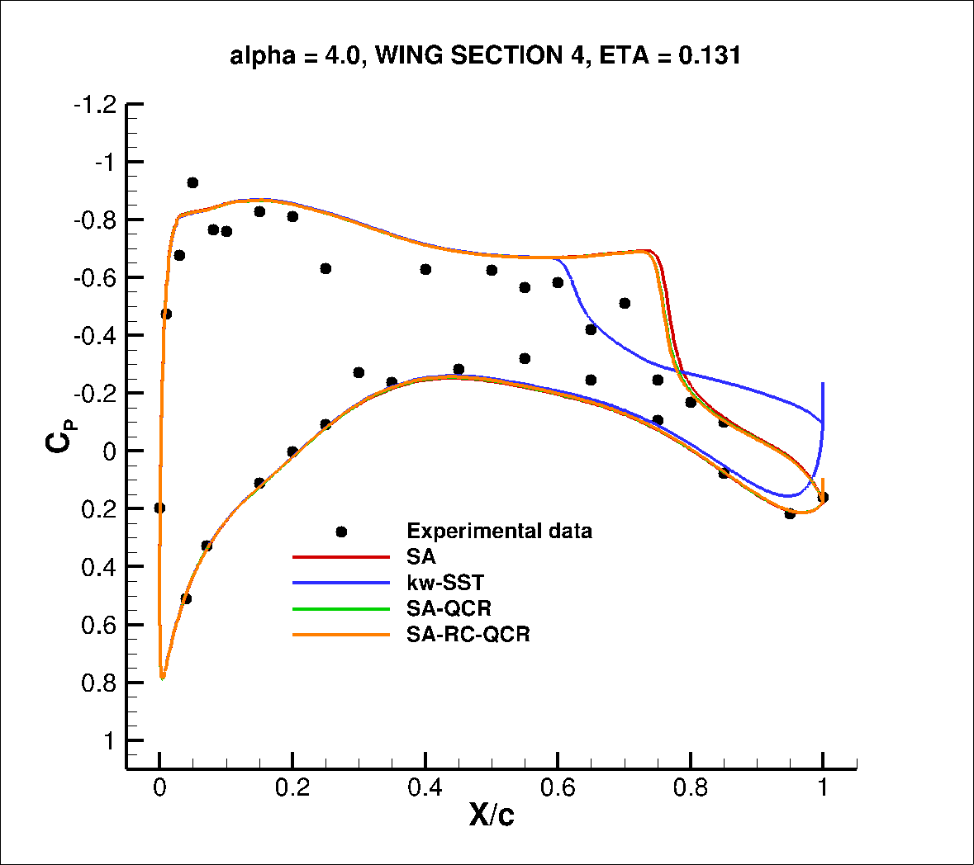
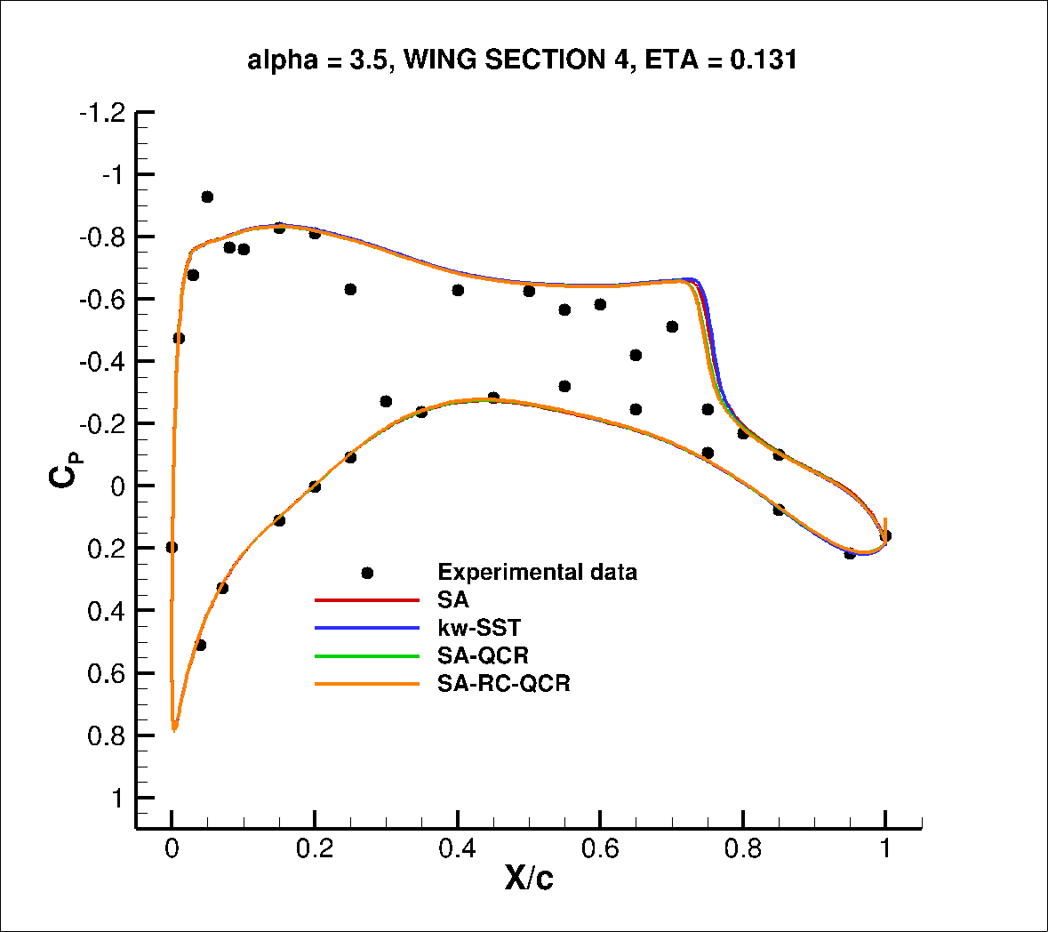
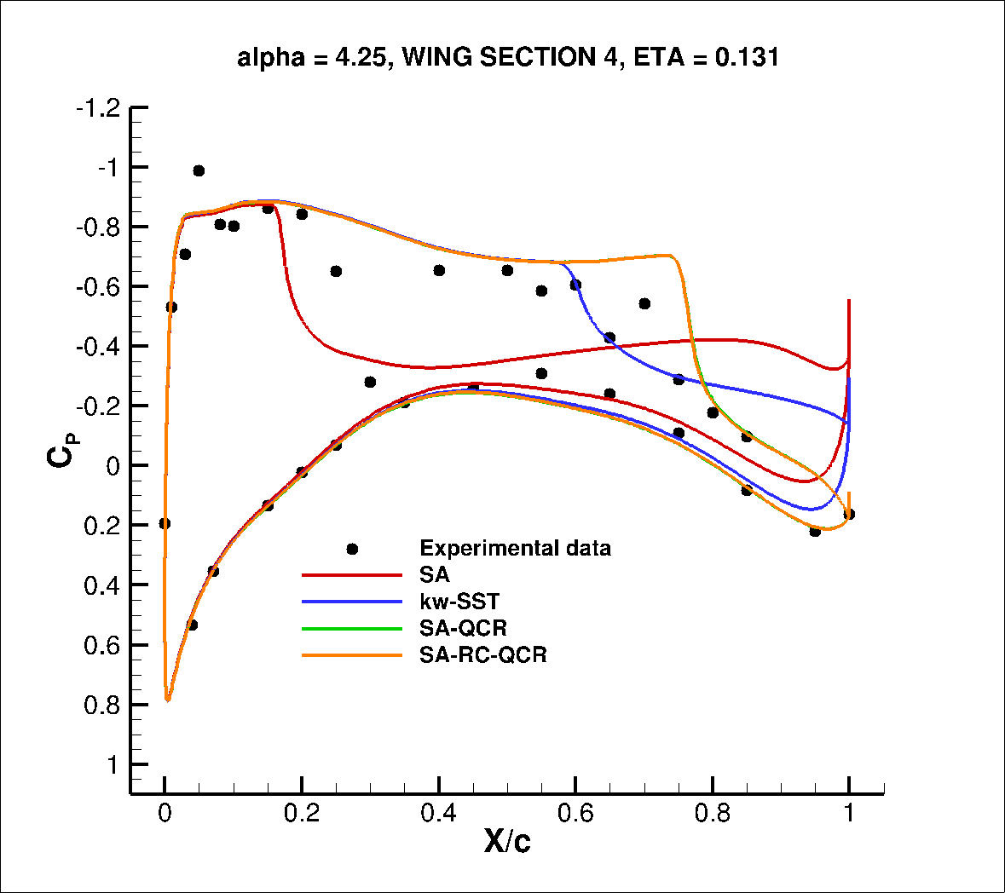
Case 2 – Alpha Sweep Study
Surface CP – eta = 0.131
t197R242 experimental data
α= 4.0
α= 3.0
α= 4.25
α= 3.5
HiQ exp. data

Slide 16
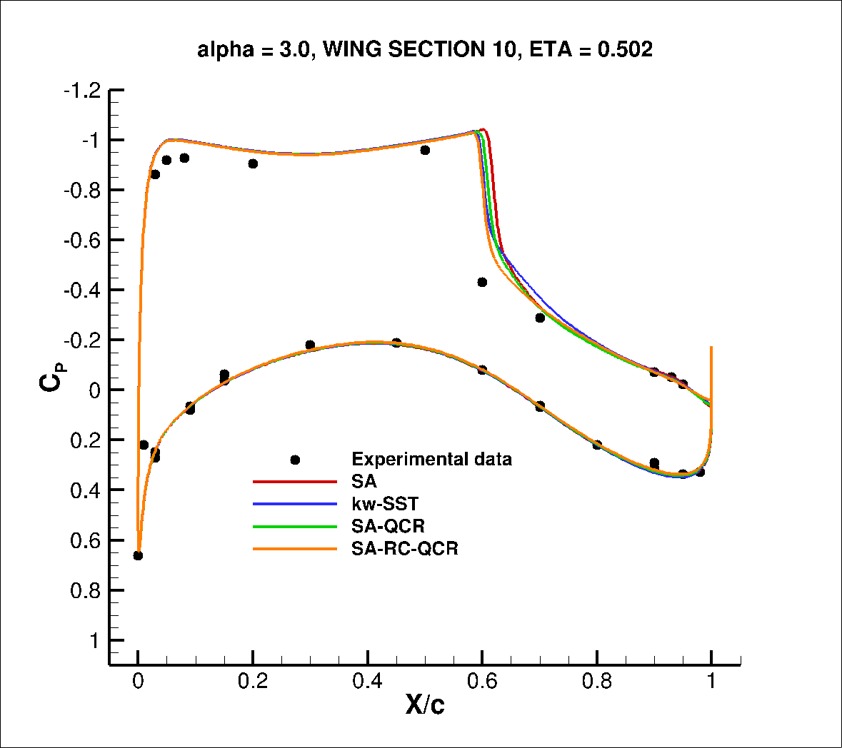
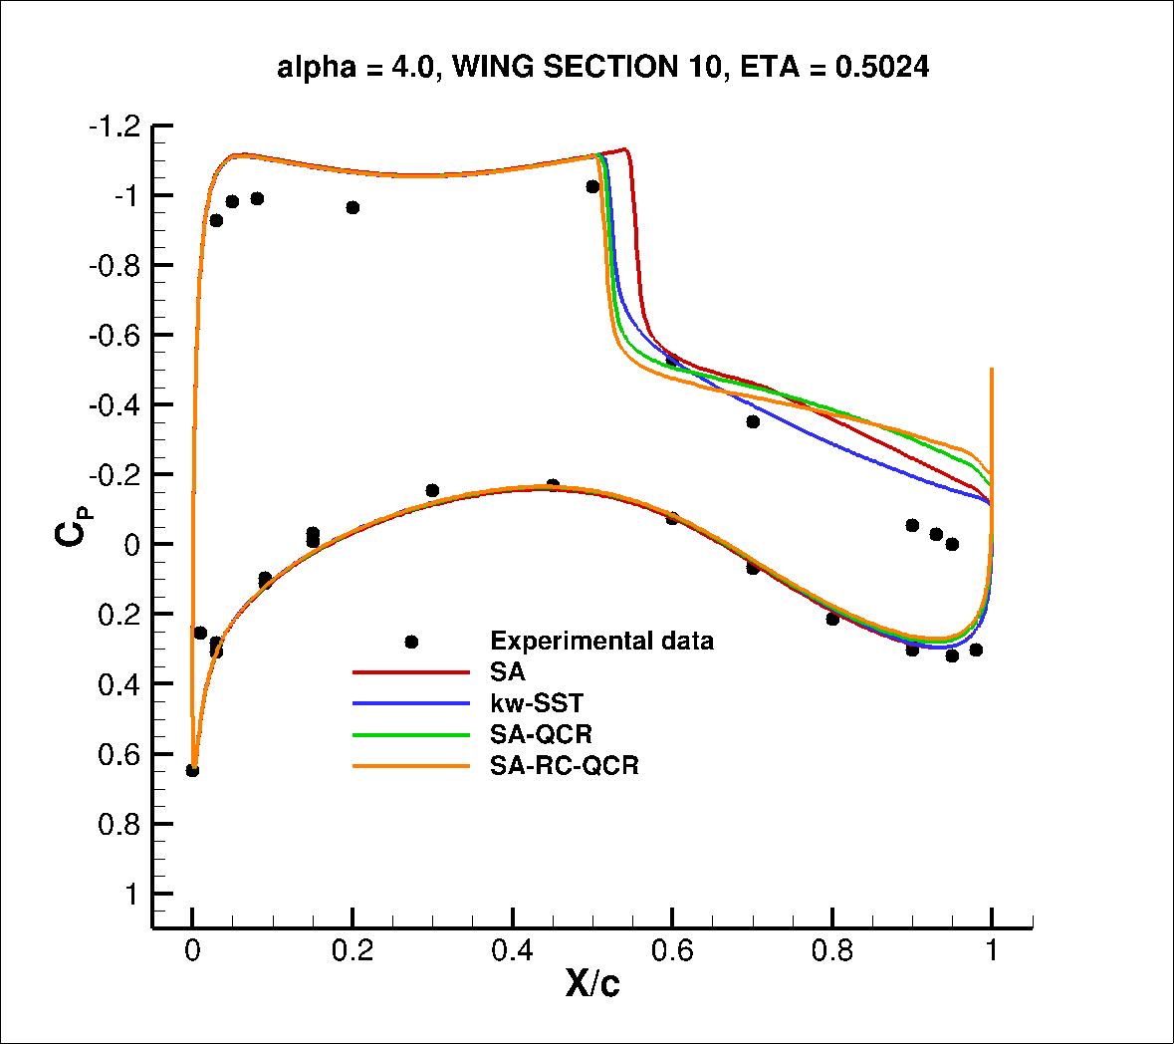
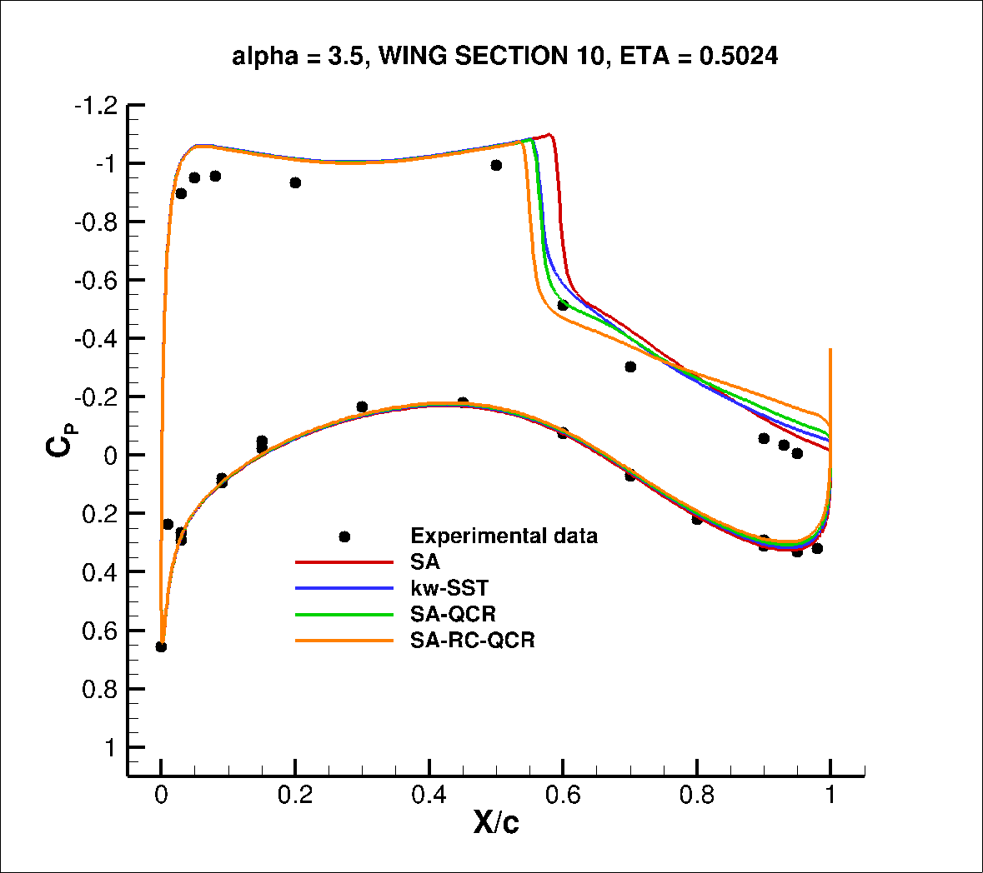
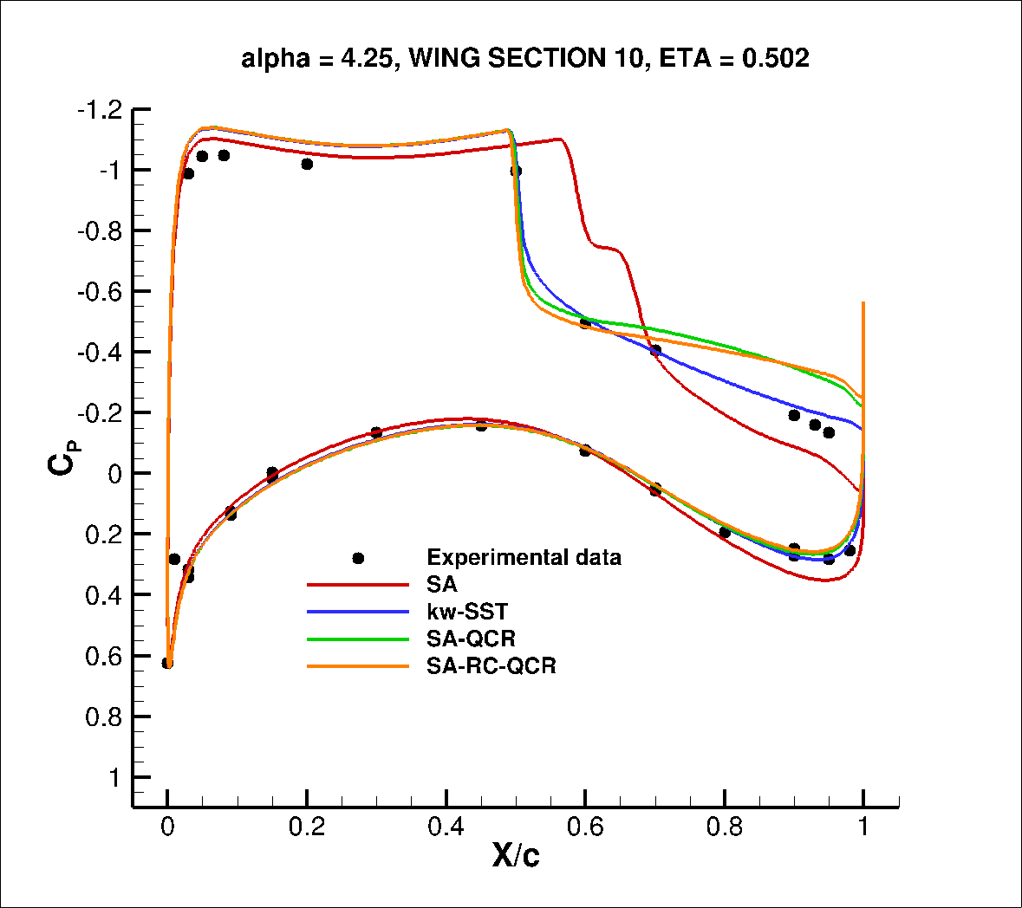
Case 2 – Alpha Sweep Study
Surface CP – eta = 0.5024
t197R242 experimental data
α= 4.0
α= 3.0
α= 4.25
α= 3.5
HiQ exp. data

Slide 17
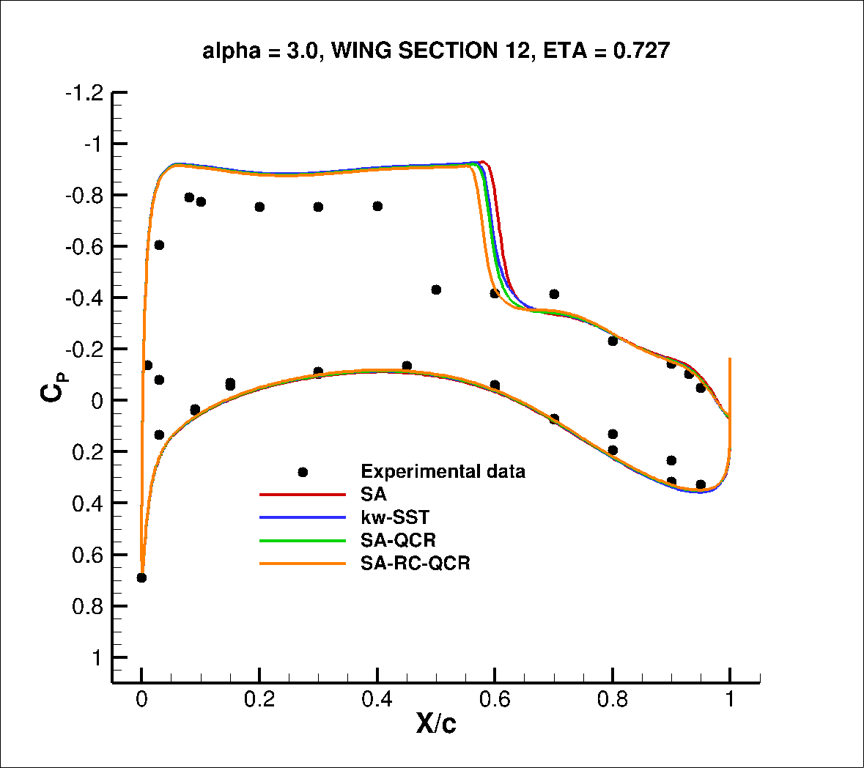
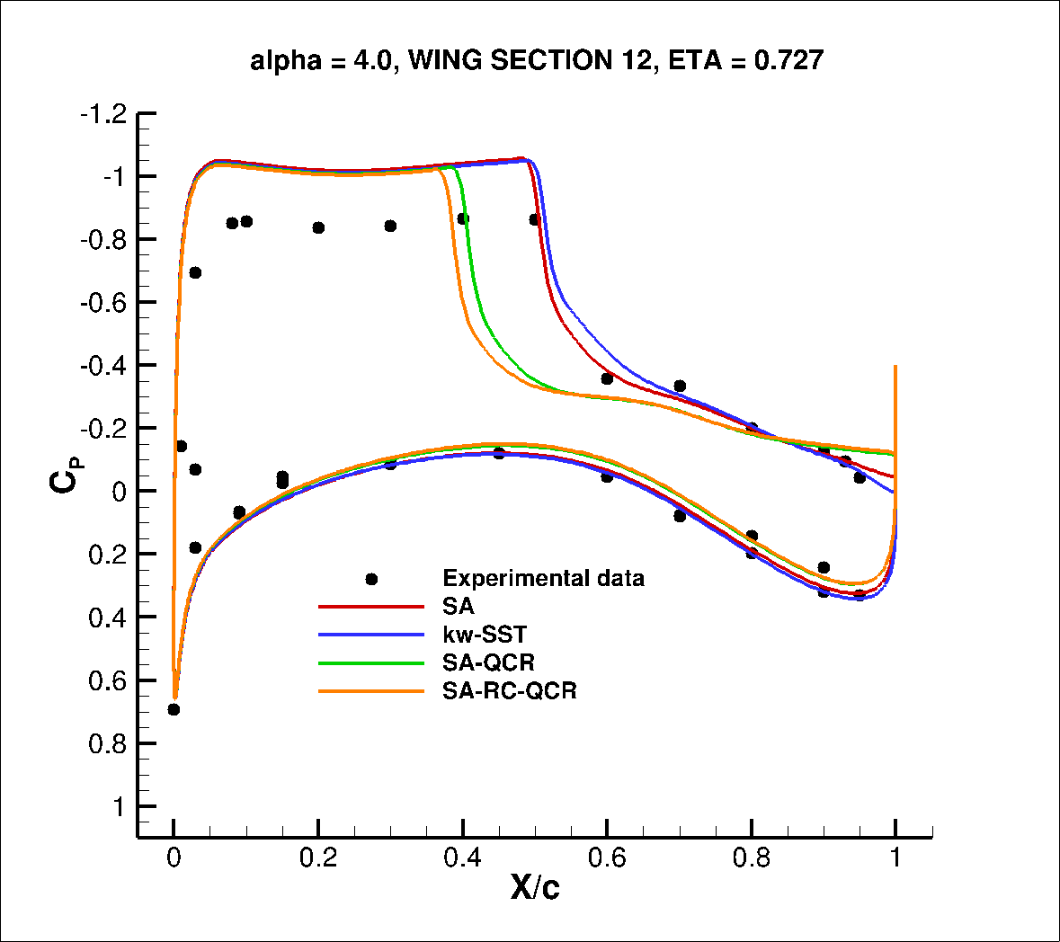
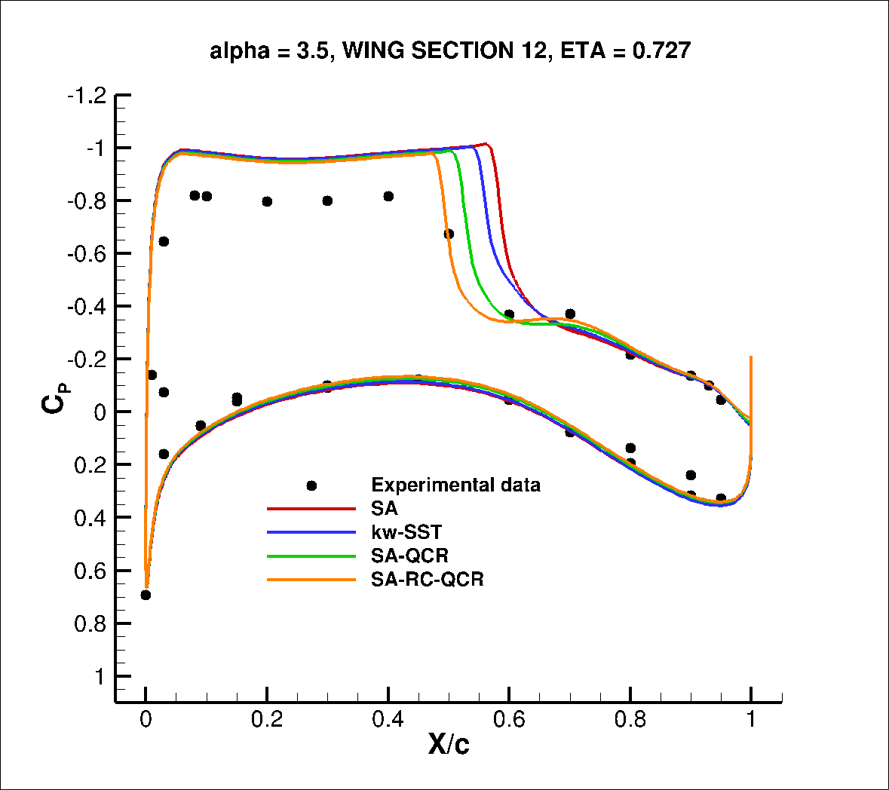
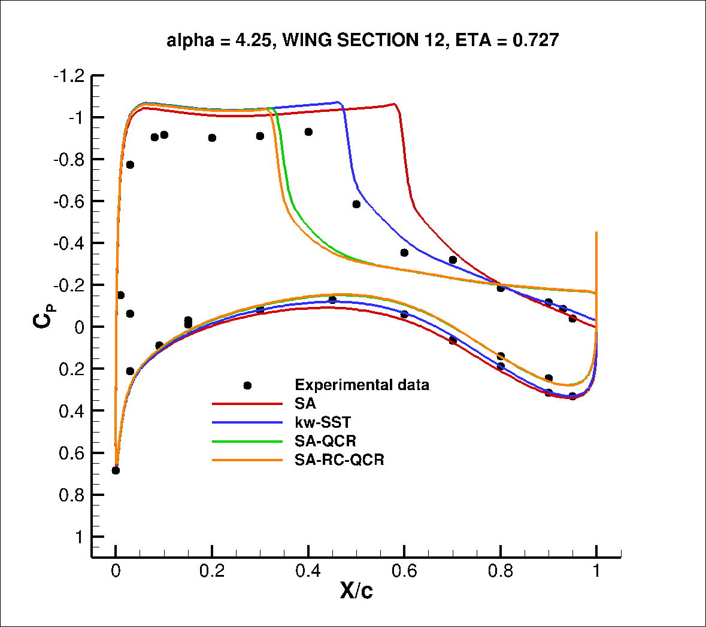
Case 2 – Alpha Sweep Study
Surface CP – eta = 0.727
t197R242 experimental data
α= 4.0
α= 3.0
α= 4.25
α= 3.5
HiQ exp. data

Slide 18
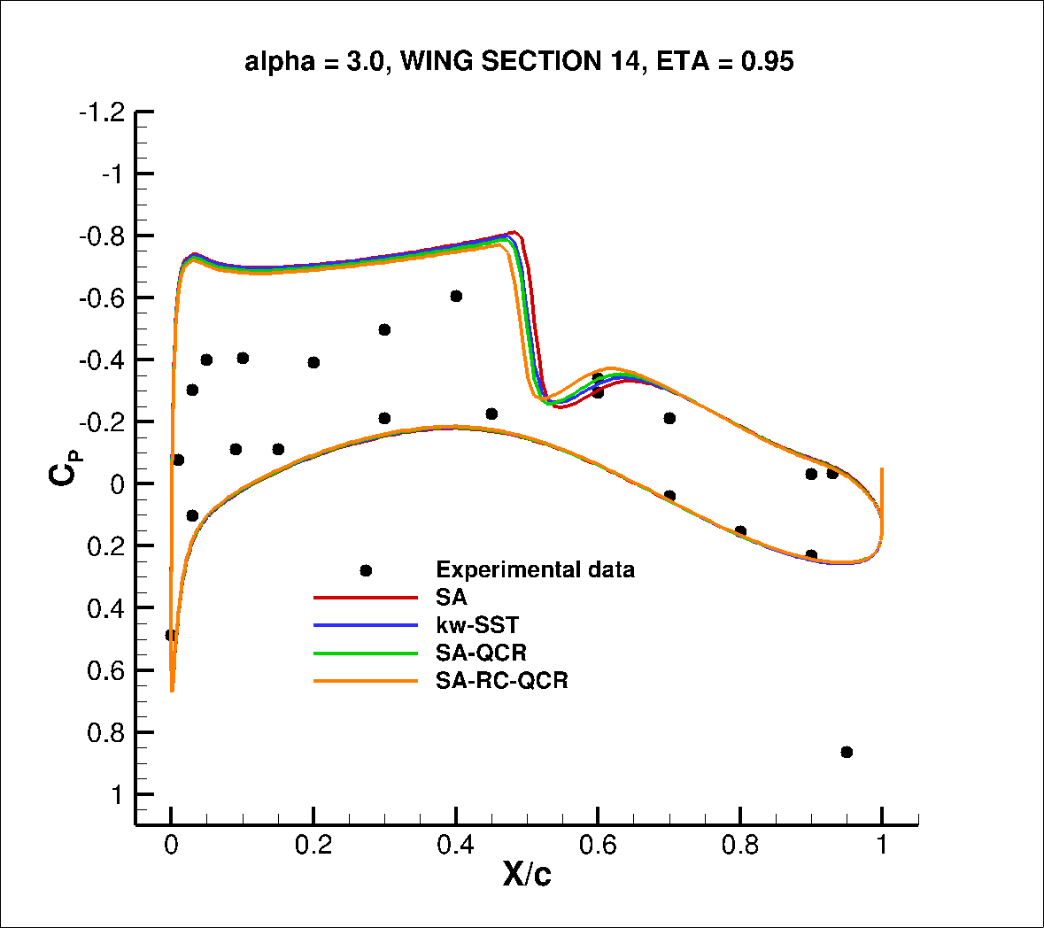
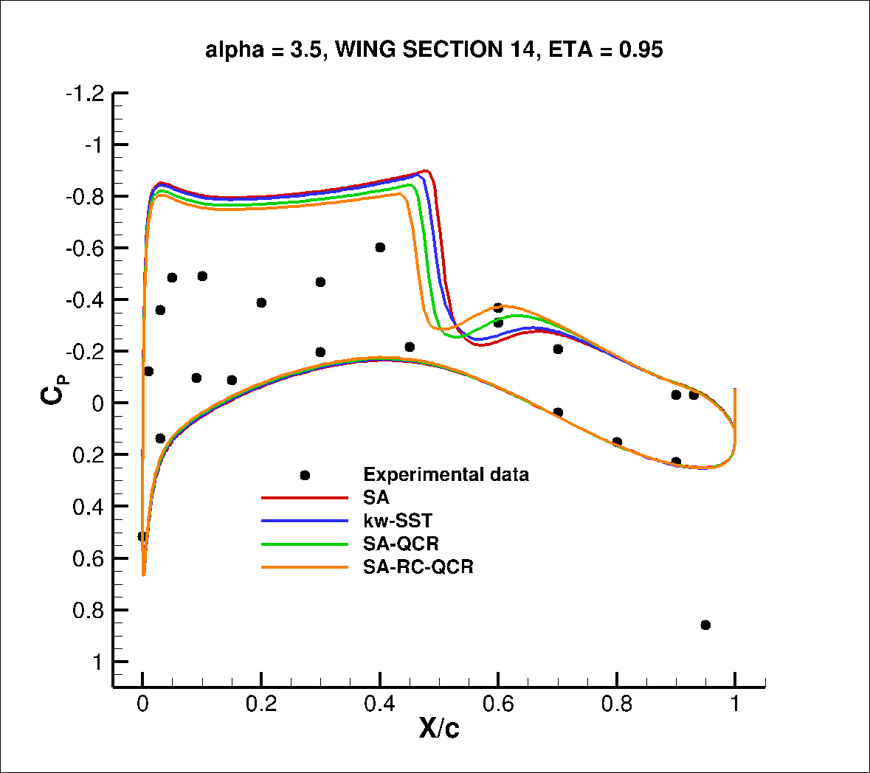
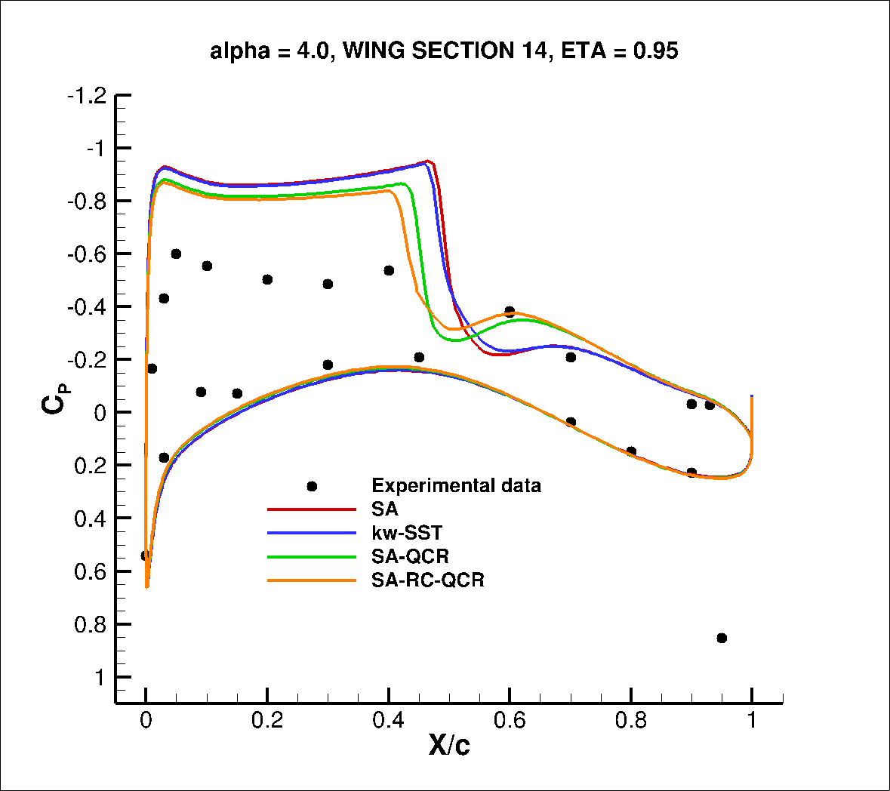
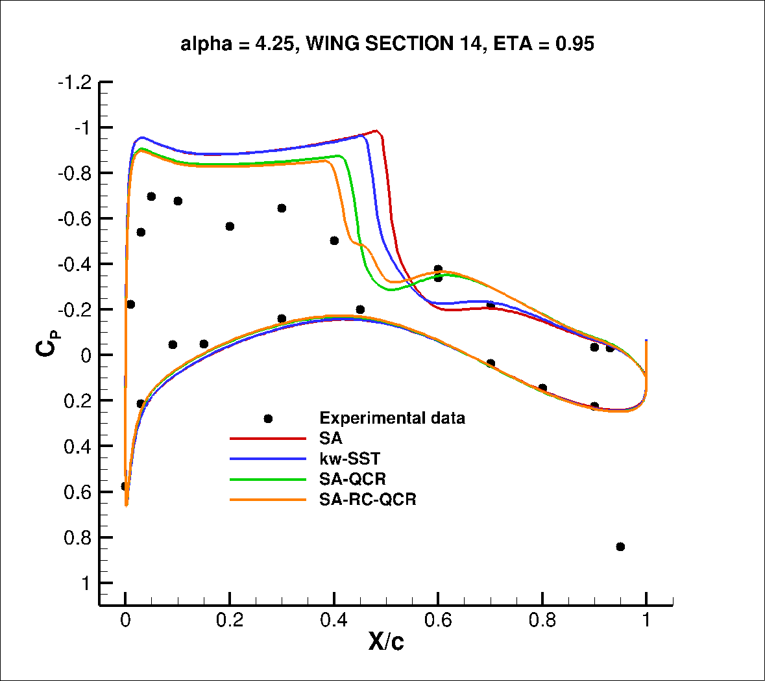
Case 2 – Alpha Sweep Study
Surface CP – eta = 0.950
t197R242 experimental data
α= 4.0
α= 3.0
α= 4.25
α= 3.5
HiQ exp. data

Slide 19
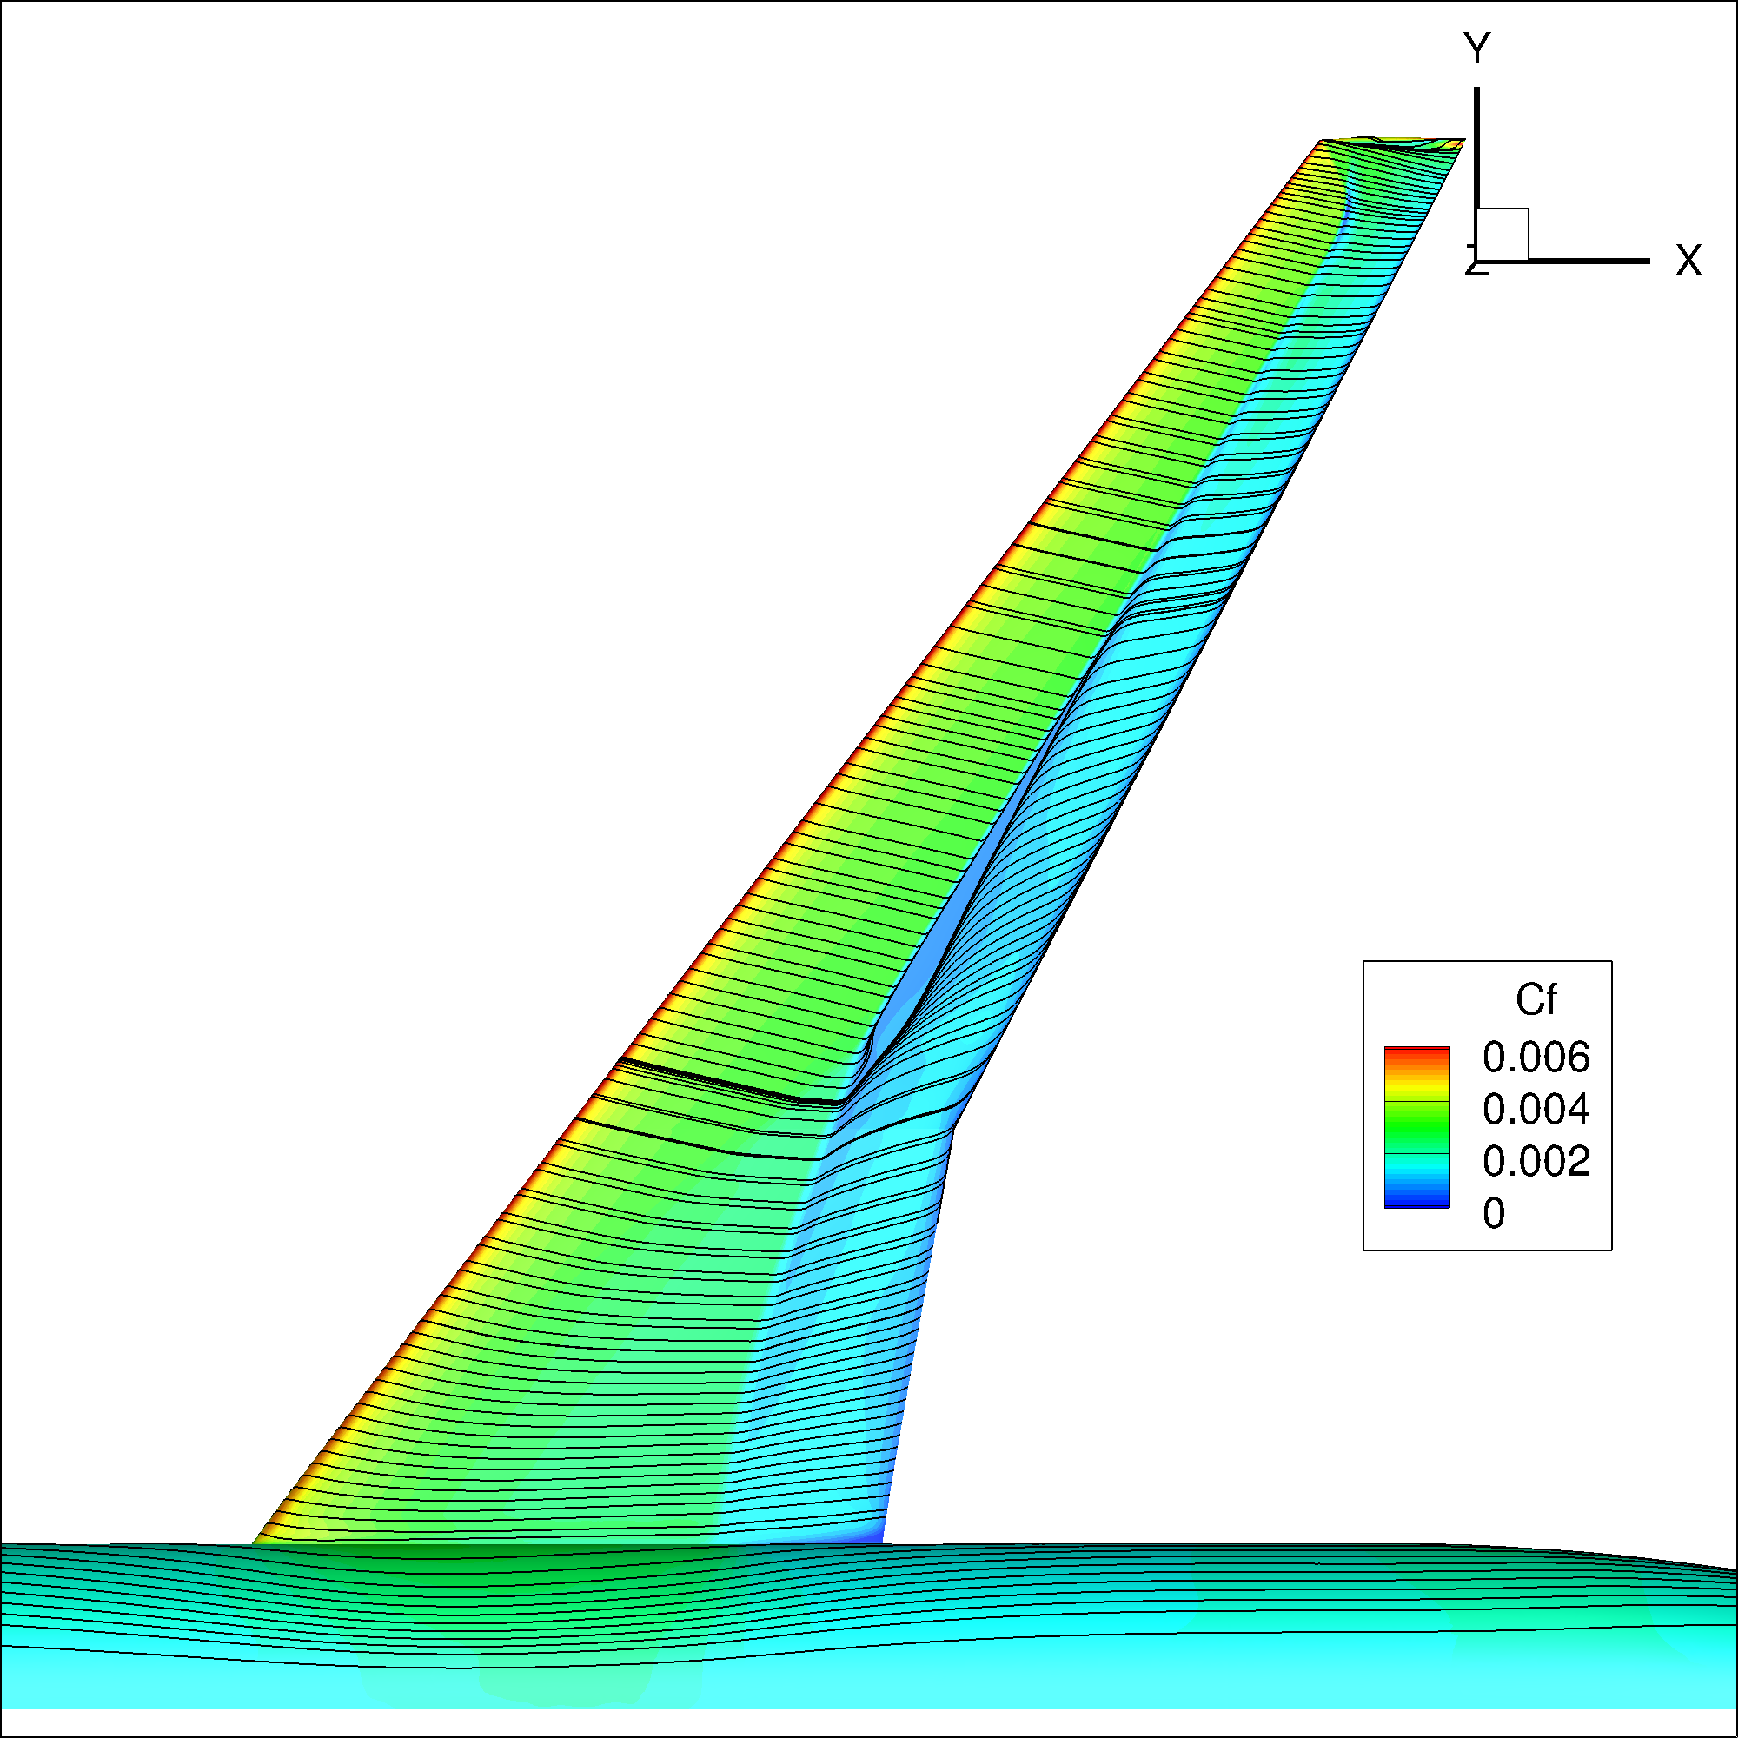

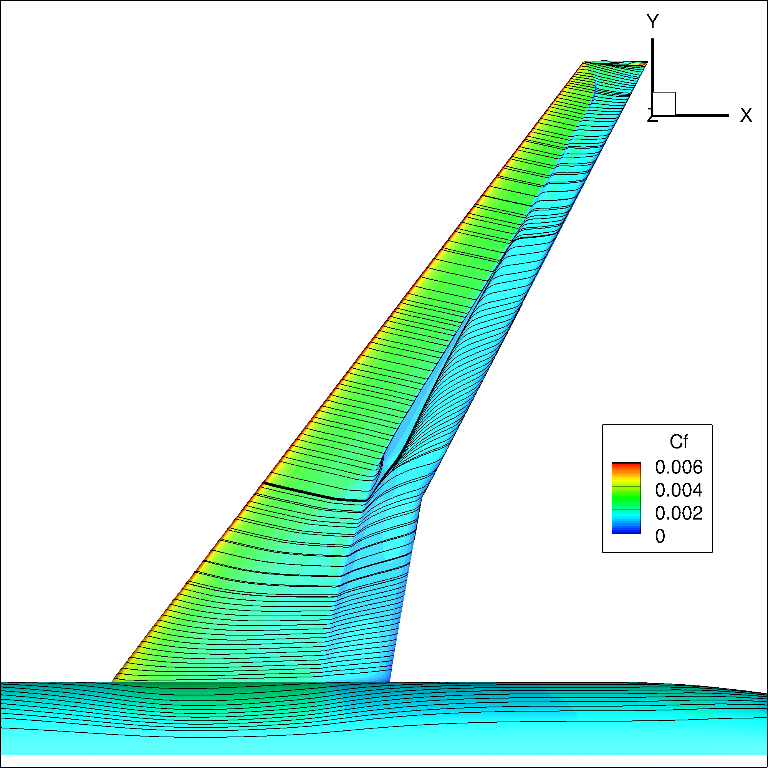

Case 2 – Alpha Sweep Study
Alpha = 3.0
SA
SA-QCR
kw-SST
SA-RC-QCR

Slide 20
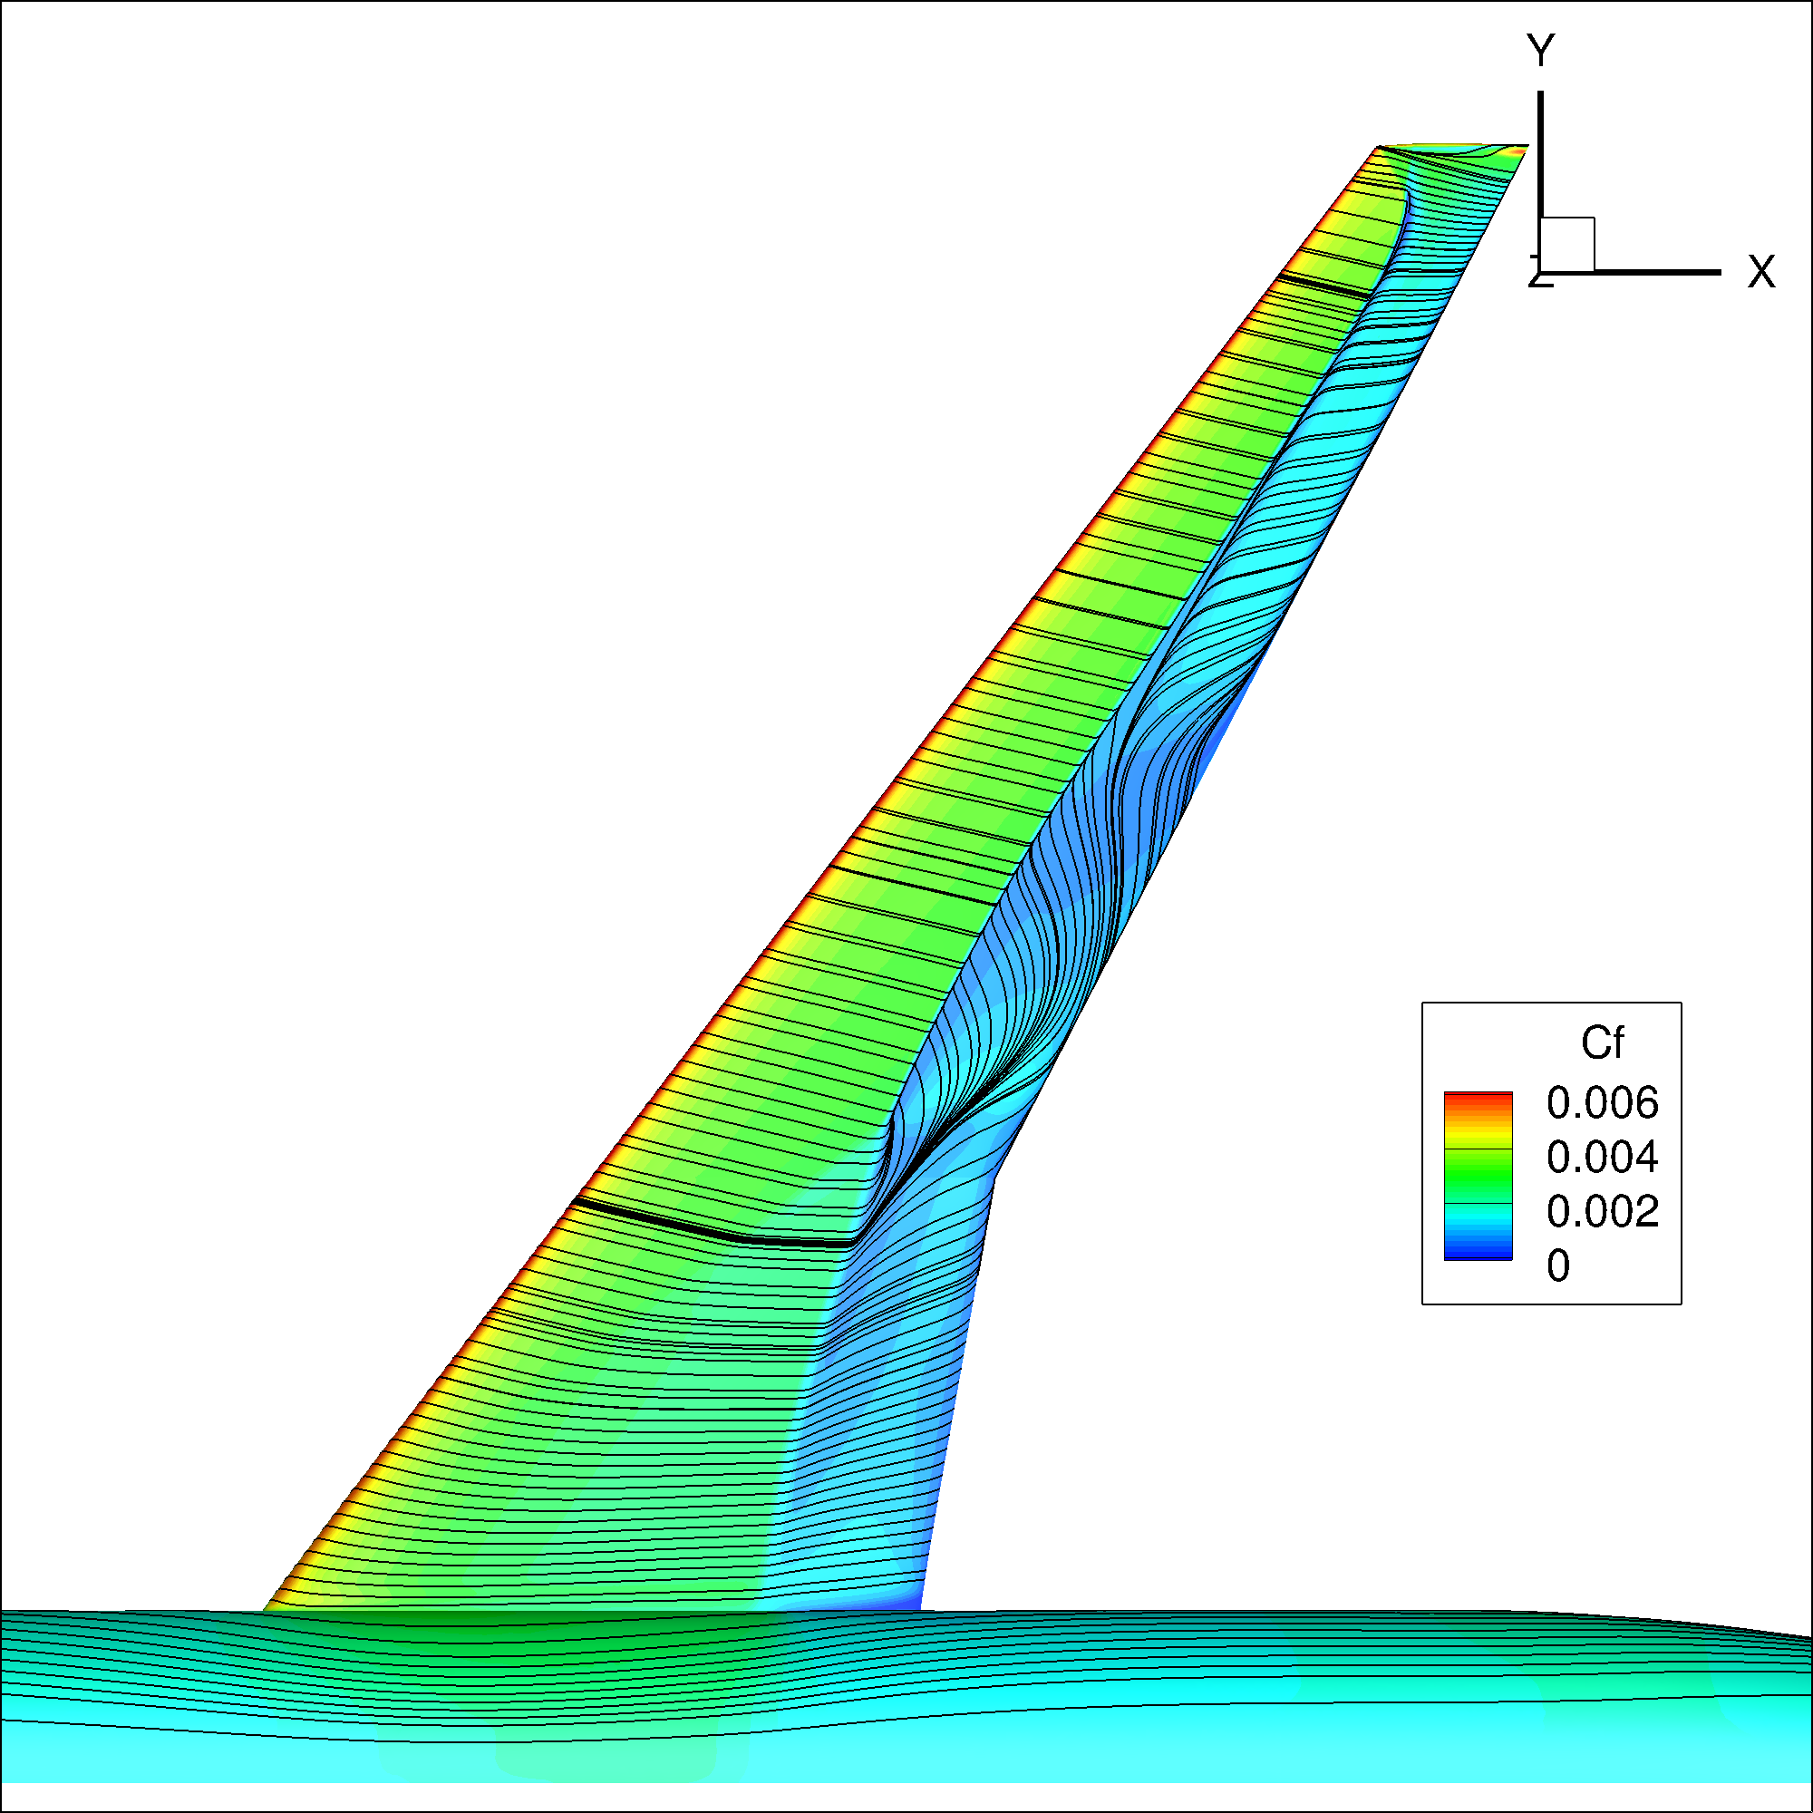
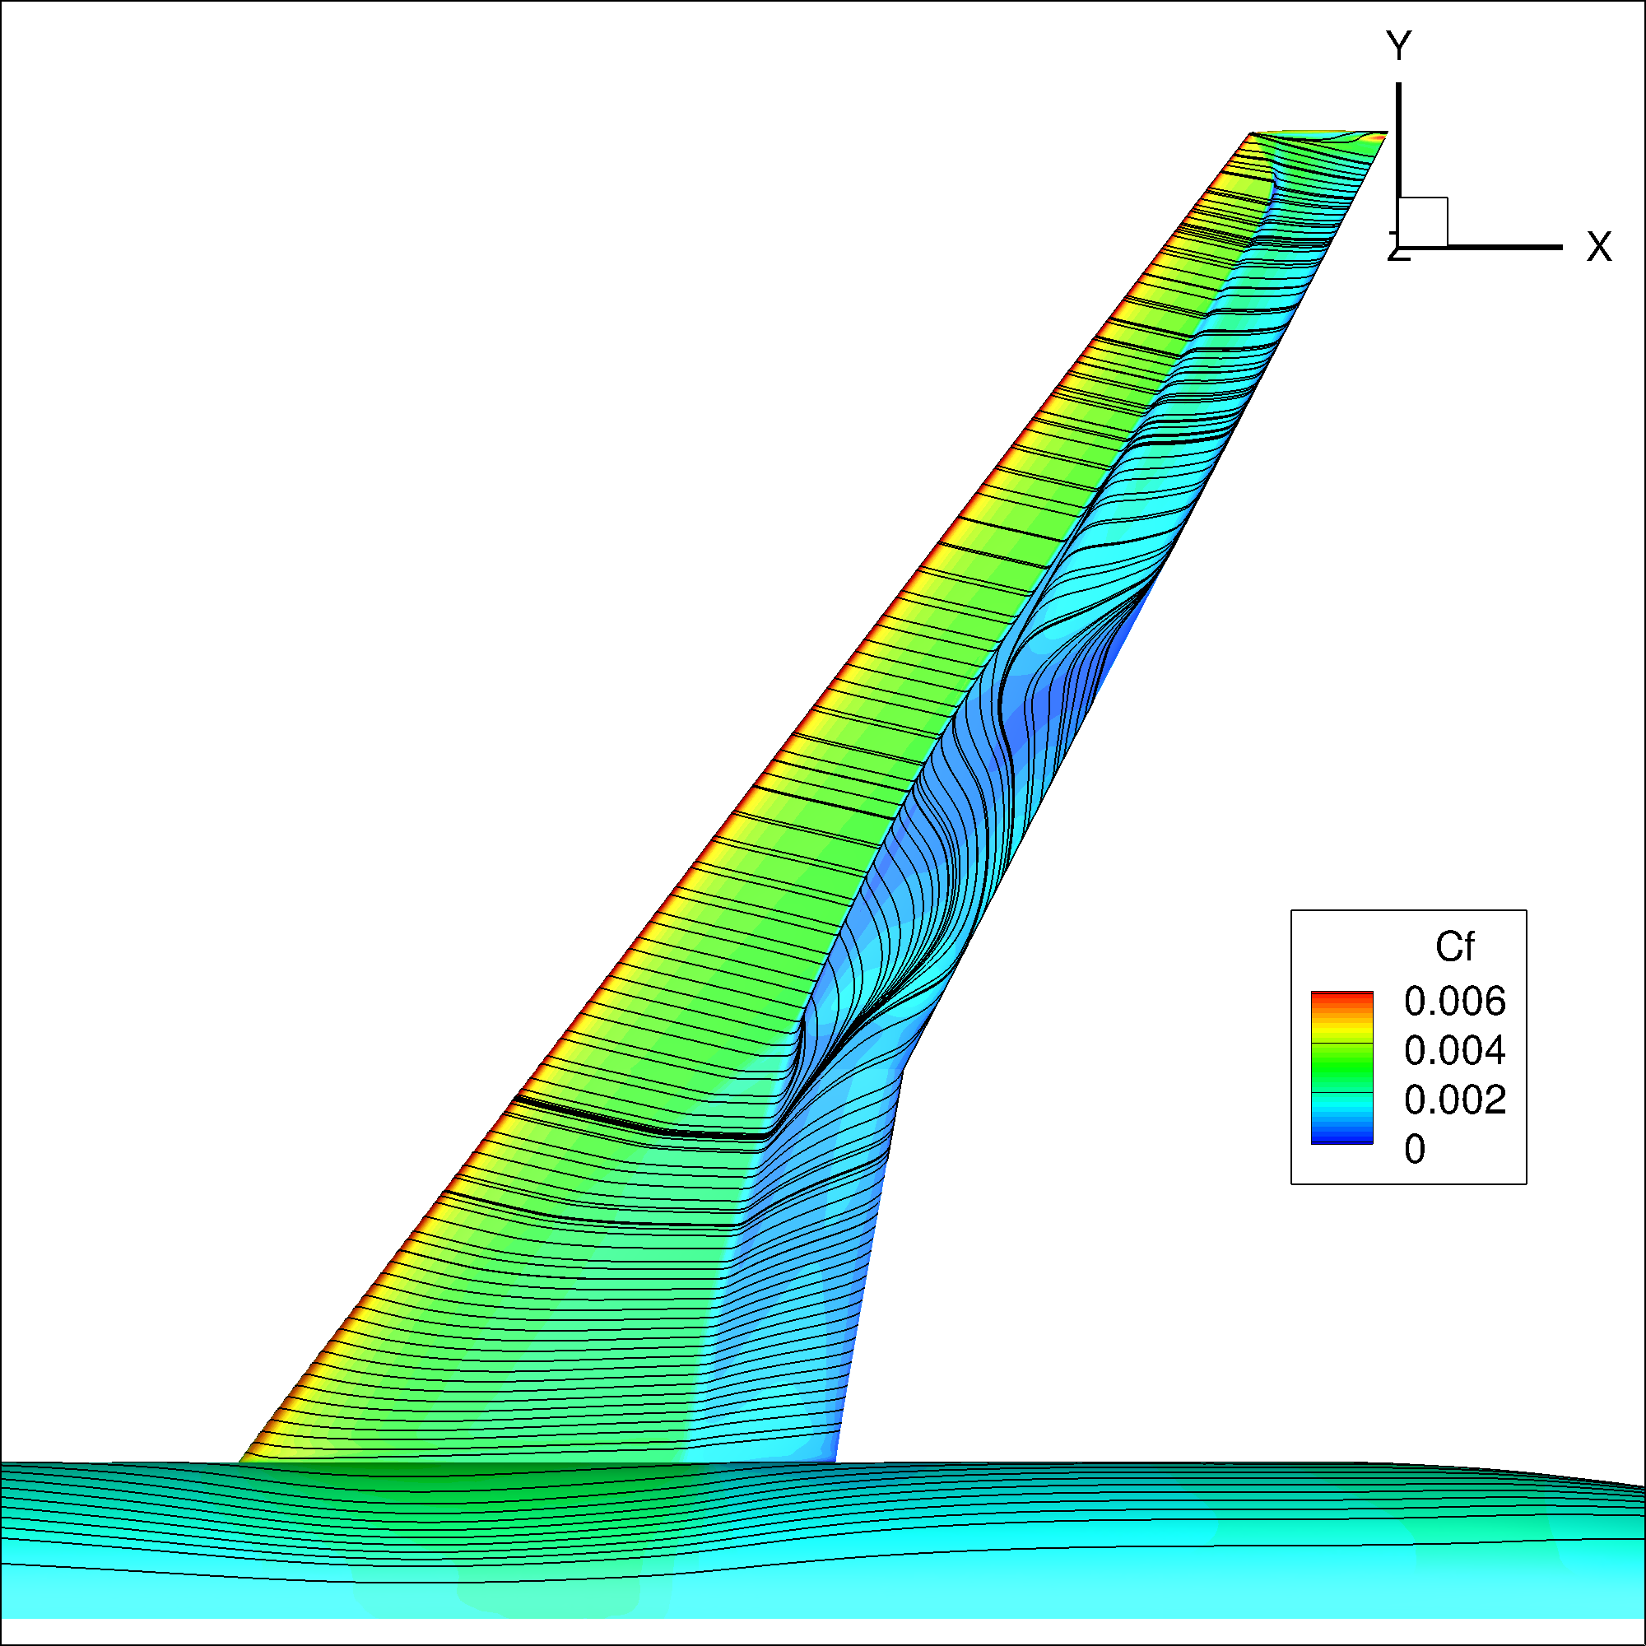
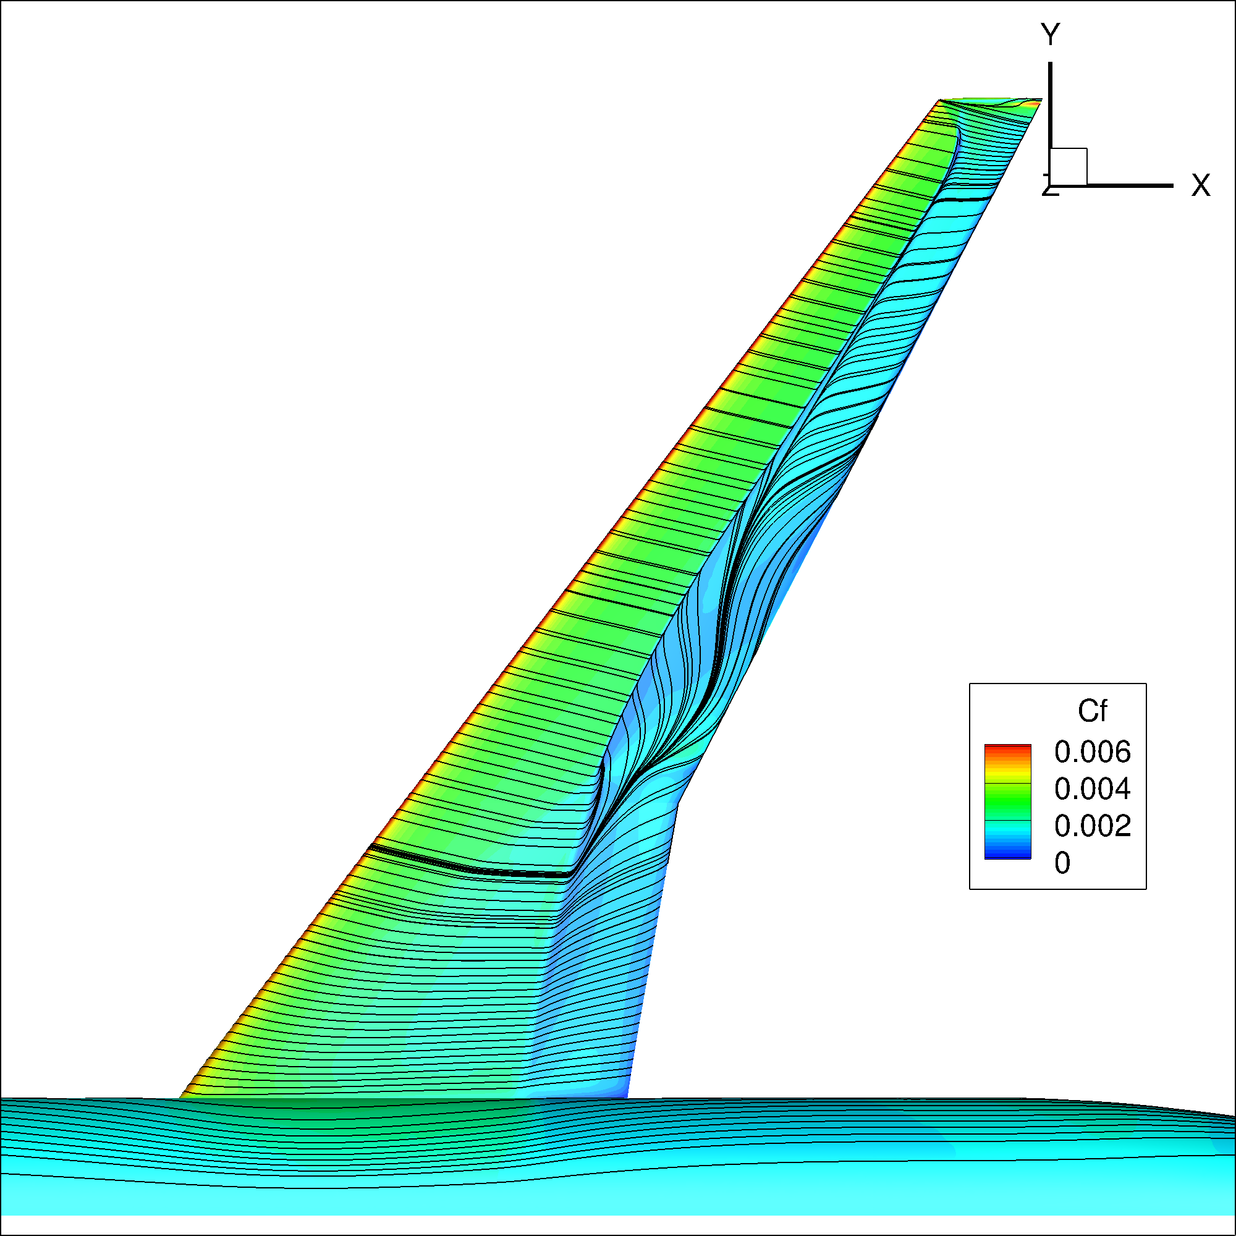
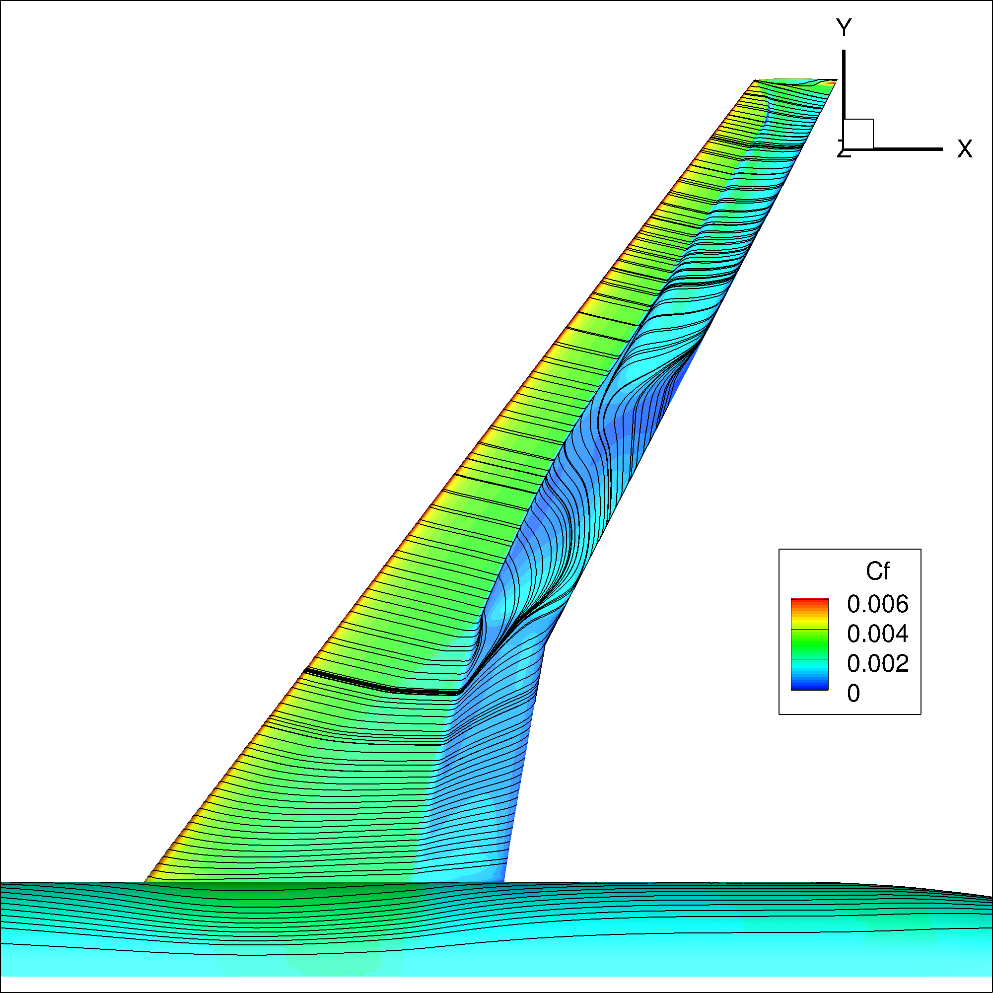
Case 2 – Alpha Sweep Study
Alpha = 3.5
SA
SA-QCR
kw-SST
SA-RC-QCR

Slide 21
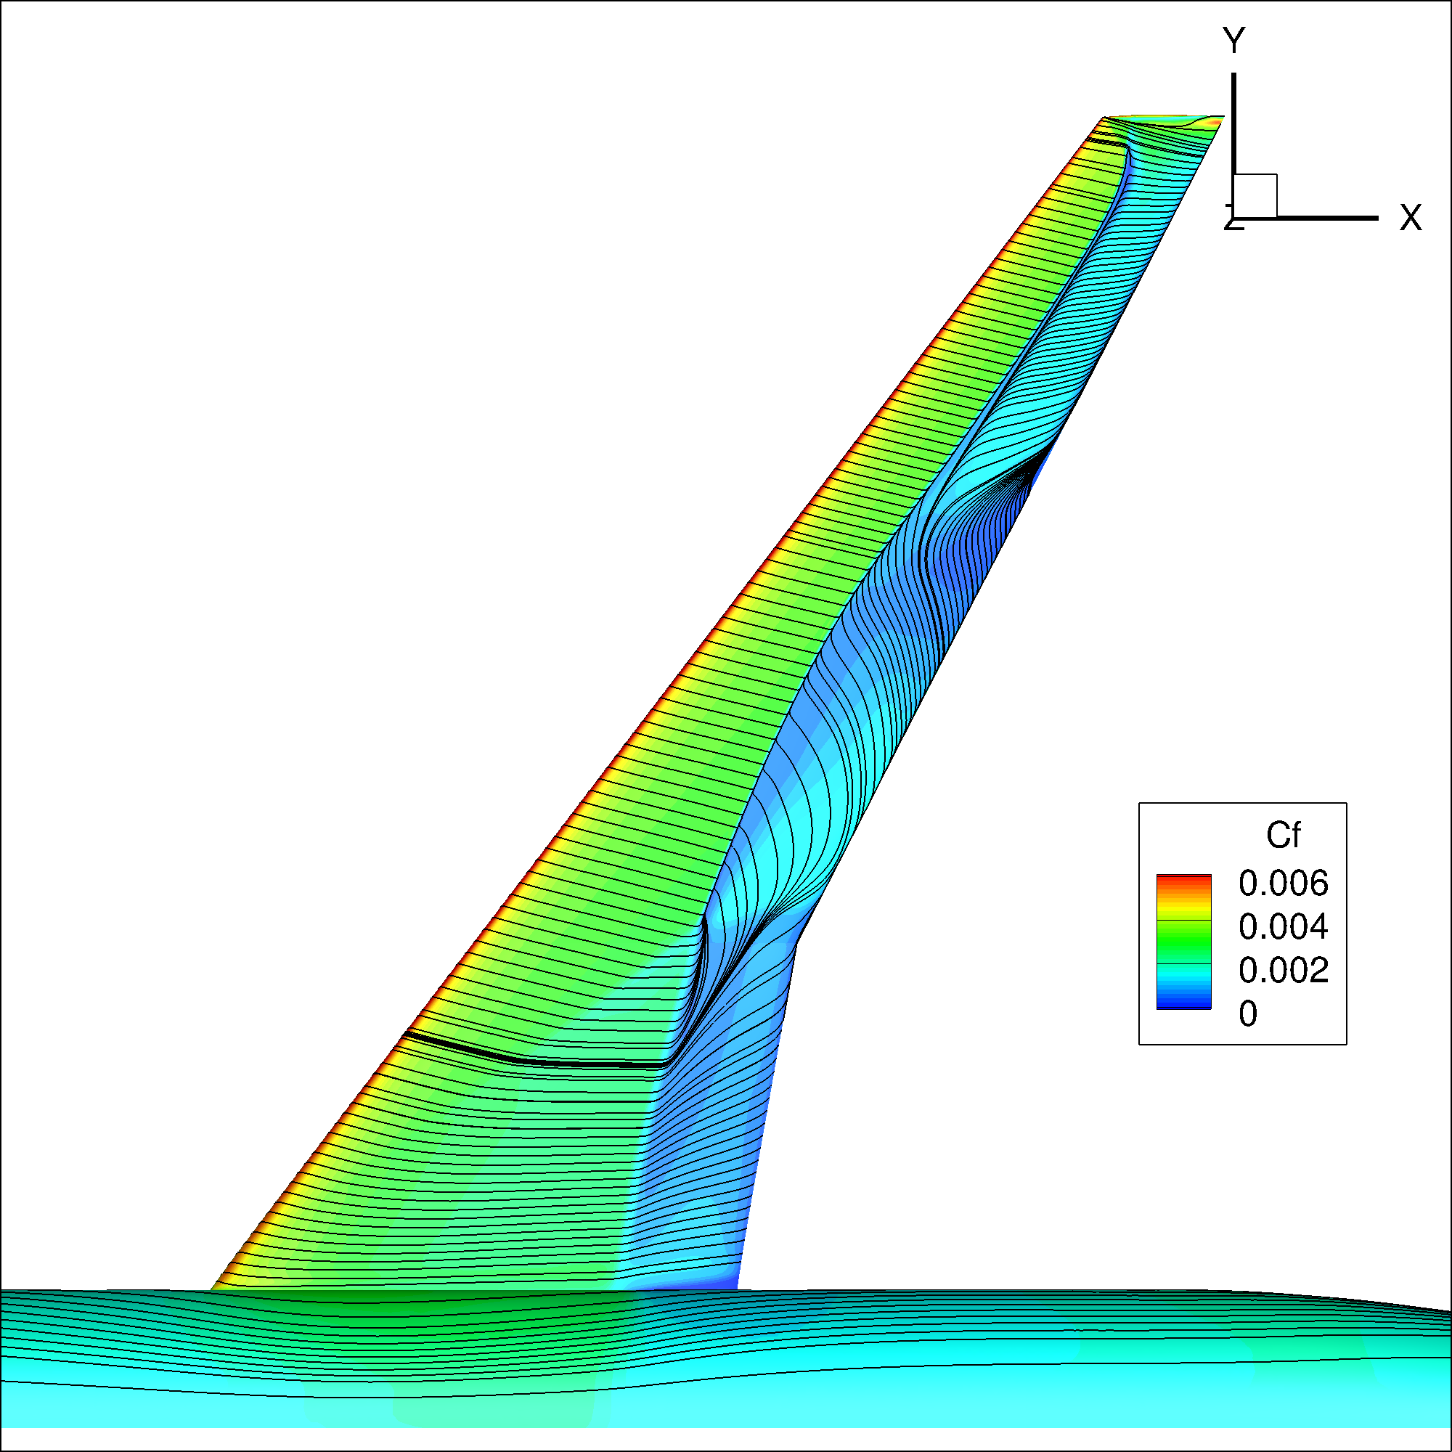



Case 2 – Alpha Sweep Study
Alpha = 4.0
SA
SA-QCR
kw-SST
SA-RC-QCR

Slide 22




Case 2 – Alpha Sweep Study
Alpha = 4.25
SA
SA-QCR
kw-SST
SA-RC-QCR

Slide 23




Case 2 – Alpha Sweep Study
Alpha = 3.0
SA
SA-QCR
kw-SST
SA-RC-QCR

Slide 24




Case 2 – Alpha Sweep Study
Alpha = 3.5
SA
SA-QCR
kw-SST
SA-RC-QCR

Slide 25




Case 2 – Alpha Sweep Study
Alpha = 4.0
SA
SA-QCR
kw-SST
SA-RC-QCR

Slide 26




Case 2 – Alpha Sweep Study
Alpha = 4.25
SA
SA-QCR
kw-SST
SA-RC-QCR

Slide 27



Case 3 – Reynolds number and Q effect study
Alpha
CD
CM

Slide 28


Case 3 – Reynolds number and Q effect study
CDp
CDv

Slide 29
Conclusions
The grid convergence study shows good convergence properties, with grid refinement primarily affecting the shock position and resolution.
The alpha sweep study showed a strong sensitivity of turbulence modelling on the result. The QCR-correction was found to significantly improve the unphysical strong separation at the root, whereas the RC-correction, shifts the shock aft.
The Reynolds number study showed reduced drag and alpha with increasing Re. whereas the Q primarily increased the alpha and reduced the negative pitching moment.
Potential further investigations:
Mesh sensitivity study -> repeat study on ultra-fine grids/ grids of a different family
Warm-started alpha sweep (each grid needs exactly the same number of nodes)
Scale-resolving simulations

